Slide 1
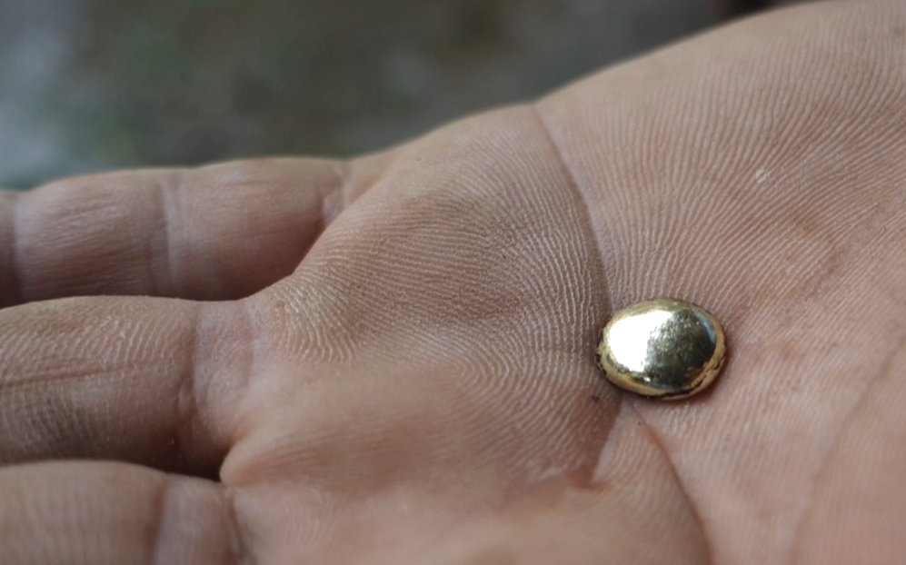
Extraccion de Oro Eficiente y Responsible
Paul Cordy, PhD
Notes:
The presenter of this workshop should become familiar with the Global Mercury Project’s “manual for training artisanal and small scale gold miners.” (2006). I will refer to this later as GMP 2006
That document will give the presenter all of the detailed information needed to deliver this course.
Golden means is for miners that want to earn more and contaminate less. Each episode tells a story about the challenges that miners face, potential solutions, and the fundamental principles that point the way toward a cleaner and richer future. In this episode we will show you how to improve milling efficiency so you can recover more gold using fewer chemicals.

Slide 2


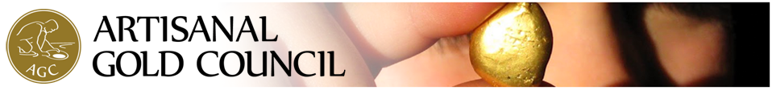
Presentado por

Slide 3



Con contribución de

Slide 4
Temas Claves
Control de Processos
Liberación
Analisis
Concentración
Economía
Notes:
These are the key themes that we will come back to throughout the presentation. Whenever the presenter explains a principle or case study they should always hit on as many of these as they can think of. For example, in the bolivian case, no control over the size of the mill feed is poor process control, and adding a crusher to adjust size with a screen to recycle the oversize is process control. This helps liberation by not introducing oversize particles. Perfect process control means that all equipment is being fed constantly and uniformly the correct size material, at the correct rate, and these parameters are calculated based on the properties of the ore and the machinery. The properties of the machinery are chosen to suit the ore. Therefore the ore designs the mineral processing plant.
Analysis of ore gives you the ore characteristics upon which you base the design of the plant. Ongoing analysis is also important during operations, to ensure that you have good process control and to understand the efficiency of your plant.
Economics: Efficiency is the amount of gold recovered divided by the amount contained in the ore, minus the cost of producing that gold. Energy, maintenance, downtime and machine wear (depreciation) are all part of the cost element of the efficiency equation. But we will focus mostly on the first part of the equation… maximizing gold recovery. This is achieved by concentration, which is capable of completely replacing mercury use.
Keep coming back to these key words throughout the presentation.

Slide 5
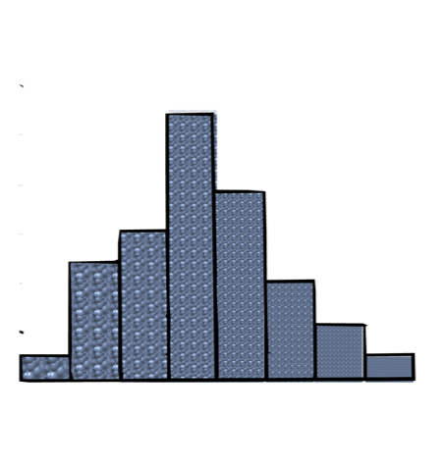
Analisis
Notes:
To control liberation, we must study grain sizes and gold concentrations. Any milled ore will have some coarser sand fragments and some fine powder. Using a set of progressively smaller screens allows you to study the distribution of grain sizes in the milled ore.
When the screens are shaken, the particles fall through, and are trapped by screens that are too small to pass, and this way we can separate the sample into grain size fractions. By weighing the amount of ore trapped by each screen, we can compare the relative amount of material of each size.

Slide 6
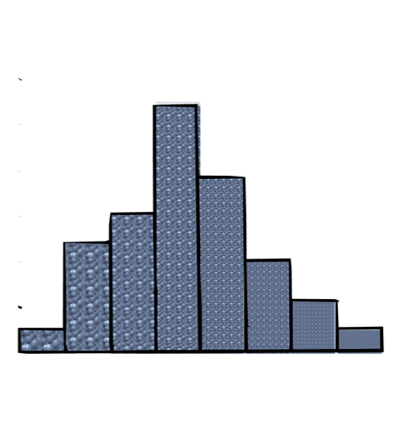
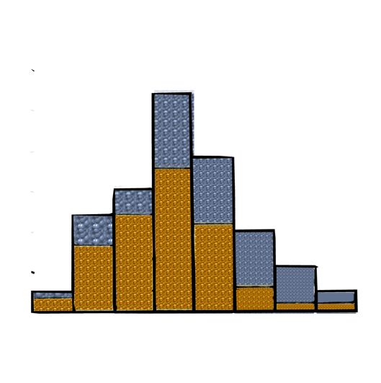
Distribucion de oro
% material
% oro
Tamaños de los granos
Notes:
This is known as the distribution of grain sizes. The height of the columns indicates the percent of the sample material in each size range.
Analysis of gold in each fraction tells you how finely to grind your ore.

Slide 7
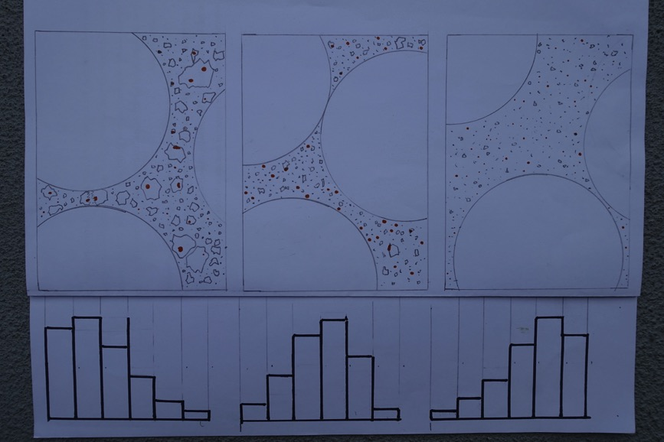
Liberación adentro del molino
Notes:
Use milling video animation sequence to show this
Lets look inside a mill to see how the ore is ground into smaller grains. In the beginning, most of the particles are relatively large,
{freeze frame, and on words “the particles” flashing highlighting (colour?) illuminates the larger grains and the two bars on the left of the graph at the same time to indicate that those columns represent the distribution of coarser grains.}
And only a few are very fine.
{freeze frame again, and on words “few are very fine” flashing highlighting (colour?) illuminates the smallest grains (which of course are relatively few, to correspond with the small bar on the right) and the two bars on the right of the graph at the same time to indicate that those columns represent the distribution of finer grains.}
As the ore is milled, the ore particles are ground finer and the distribution of grains shifts right towards smaller sizes. Ideally, most grains fall in the middle of the distribution.
{freeze frame again, and on words “most grains fall in the middle” flashing highlighting (colour?) illuminates the middle bars}
Milling too long grinds most of the particles into a fine powder.
{freeze frame again, and on words “a fine powder” flashing highlighting (colour?) illuminates the smallest grains (which are now the majority of grains, to correspond with the now larger bars on the right and illuminate at the same time to indicate that those columns represent the distribution of finer grains. unfreeze animation and go to extreme end point during the following narration:}

Slide 8


Distribucion de oro
% material
Oro demasiado fino para recuperar
Oro no liberado
% gold
Notes:
Often this is unnecessary, and is therefore a waste of money, time, and as we will soon see, loses a lot of gold.
Now lets look at how much gold there is in each size fraction. this can be done by panning each size fraction and weighing the resulting gold, or by chemical analysis in a laboratory.
{go back to idealized distribution, now overlay new gold % axis and gold bars}
Now instead of the percentage of the total sample material that passes each screen, lets look at the percentage of the total gold in the sample that is contained in each size fraction. This is the distribution of gold in the sample.

Slide 9

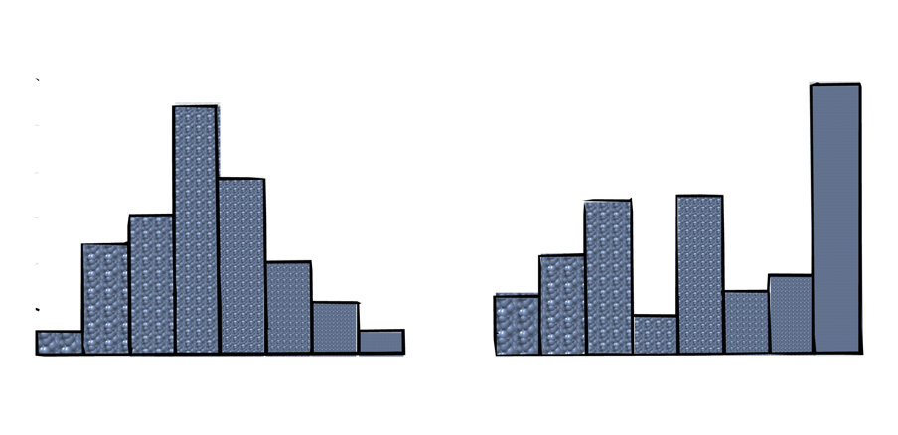
Distribución de granos en las colas
Molido demasiado
Molido insuficientemente
Colas de molienda eficiente
Verdadera distribución de granos en el caso Boliviano
Notes:
Here is the distribution of grain sizes in the tailings of this mine. The reason there are two peaks and lots of fines in the tails, is that very large pieces are not ground fine enough because they started too big. The finer fraction was milled for too long, and ground so fine that lots of gold is lost as fines that cannot be amalgamated.
{THIS IS REAL DATA FROM bolivia, show distribution and highlight fines and coarse where losses occur}
If they improved their milling by crushing their to the optimal size before milling, add X water for Y ore, use the right milling speed, they could make their ore distribution look more like the distribution on the left. Amalgamation of the well milled ore would produce more gold than they do now

Slide 10
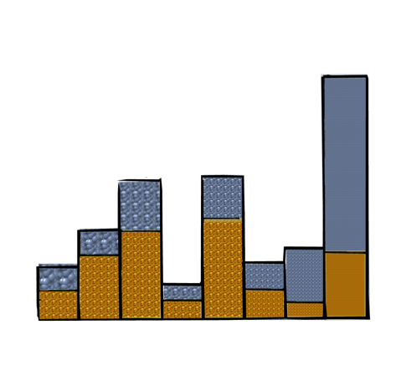
Pobre liberación, poca eficiencia
Notes:
The ore has over 5 g/T
{add gold bars to the distribution, flash 5 g/T on screen. Splash mercury across the graph, have them drip down through the columns, dragging away gold particles and draining off but leaving mercury coatings and the unliberated/too fine gold behind. Columns below show the amount of gold caught by amalgamation.}

Slide 11
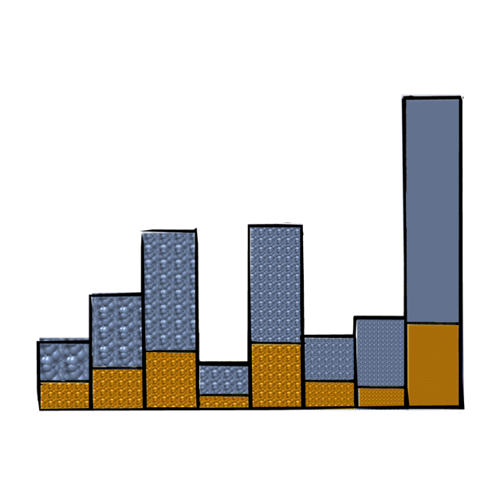
Notes:
and the tailings have 2 g/T of gold in them, meaning that they flush most of the gold in their ore down into the creek. Each tonne of tailings also has 25 g of mercury in tiny droplets and coatings on silt.

Slide 12
Control de Processos
Tamaños
Alimentación
Maquinaria
Notes:
Explain sizing, feed rate, and machinery optimization (mill capacity has to match concentration equipment capacity as an example.)
Size: GMP 2006: page 16-32
Feed: GMP 2006: page 12-14, 39

Slide 13
Chancador y control de tamaños
Notes:
Process control by screen filters out smaller particles and crushes the oversize. Two crushers in sequence ensures perfect feed sizing.

Slide 14
Notes:
If they improved their milling by crushing their to the optimal size before milling, add X water for Y ore, use the right milling speed, they could make their ore distribution look more like this. Amalgamation of the well milled ore would produce more gold than they do now

Slide 15
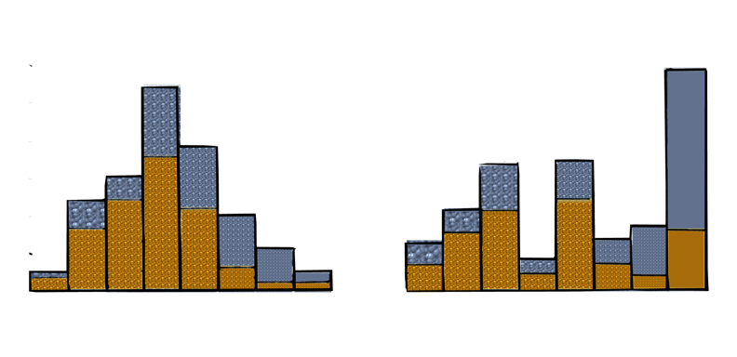
Mejor molienda, mayor liberación, poca generacion de finos = Más Oro!
Notes:
{Compare with well milled ore distribution with gold side by side with real tails distribution;
But its possible to recover the same amount of gold or more with mercury free concentration techniques. In episode two we discuss concentration in detail, but for now lets look at the difference between good and poor liberation on the shaker table.

Slide 16
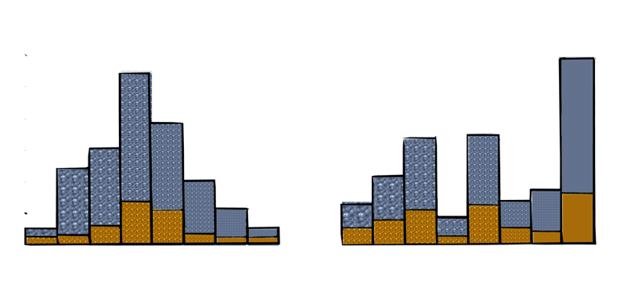
Notes:
The coarse unliberated (left column of distributions) and overly milled fine gold is lost in best practices and worst. The difference is that best practices produce less unliberated and fine gold.

Slide 17
Ingineros locales muestran perdidas
Notes:
Highlight importance of doing demonstrations on site at their mine using their mineral using only a small addition of kit. By drawing off the finer fraction of the milled slurry, we can show how much more efficient other concentration methods are compared to amalgamation plates. The coarse fraction is reintroduced to the mill so that the miners don’t have to fear that we increase their losses because of the pilot testing.

Slide 18
Molienda secundaria
Notes:
This is why milling is the most important step in the production chain; it frees the gold to be captured by concentration or chemical separation.
The simplest way to increase milling efficiency is to add the right amount of water, ore, and steel balls. Next, crushing to the optimal size will ensure proper liberation. More advanced operations would feed the coarse fraction of to a secondary mill to get the best possible liberation without overgrinding the fine gold.

Slide 19
Análisis
Optimización para el mineral
Seguimiento de eficiencia
planificación
Tamaño de oro
Perdidas en colas
Pruebas de liberación
Notes:
GMP 2006: page 10-14,
Perfect process control means that all equipment is being fed constantly and uniformly the correct size material, at the correct rate, and these parameters are calculated based on the properties of the ore and the machinery. The properties of the machinery are chosen to suit the ore. Therefore the ore designs the mineral processing plant.
Analysis of ore gives you the ore characteristics upon which you base the design of the plant. Ongoing analysis is also important during operations, to ensure that you have good process control and to understand the efficiency of your plant.
Economics: Efficiency is the amount of gold recovered divided by the amount contained in the ore, minus the cost of producing that gold. Energy, maintenance, downtime and machine wear (depreciation) are all part of the cost element of the efficiency equation. But we will focus mostly on the first part of the equation… maximizing gold recovery. This is achieved by concentration, which is capable of completely replacing mercury use.
Keep coming back to these key words throughout the presentation.

Slide 20
Notes:
Well liberated gold and heavy minerals make thick and discrete lines on the shaker table. This poorly liberated ore doesn’t separate well because many grains still contain light and heavy minerals bound together.
{freeze frame on thick grains that are clearly composed of many different minerals}

Slide 21
Concentración
Oro liberado
Cadenas de concentracion
Mejor recuperación sin químicos
Notes:
GMP 2006: page 34-51
Reinforce the chain of concentration tools progressively captures losses.

Slide 22
Concentración
Tamaño de particulos de oro (milimetros)
Canaletas
Espiral
“Blue Bowl”
Mesa Vibratoria
Centrifugo horizontal
Flotación
Centrifugo Knelson o Icon o Russo
Malla
Notes:
Different methods are optimal for different sizes of gold. Centrifuges and floatation are the only things that will capture fine gold efficiently. This is important for the final exercise, where students have to choose the right equipment for their ore. This slide should be shown again at the end of the exercise, and maybe even added as a handout during the exercise.
Explain each tool GMP 2006 p34-51

Slide 23
Concentración
Proporción de concentración:
Peso de mineral original
÷
Peso de concentrado
Notes:
Do a sample calculation as in the handouts of the exercise to demonstrate concentration ratio.

Slide 24
Notes:
This is a series of pictures to use while the presenter explains each piece of equipment to the class in preparation for the exercise.

Slide 25
Notes:
This is a series of pictures to use while the presenter explains each piece of equipment to the class in preparation for the exercise.

Slide 26
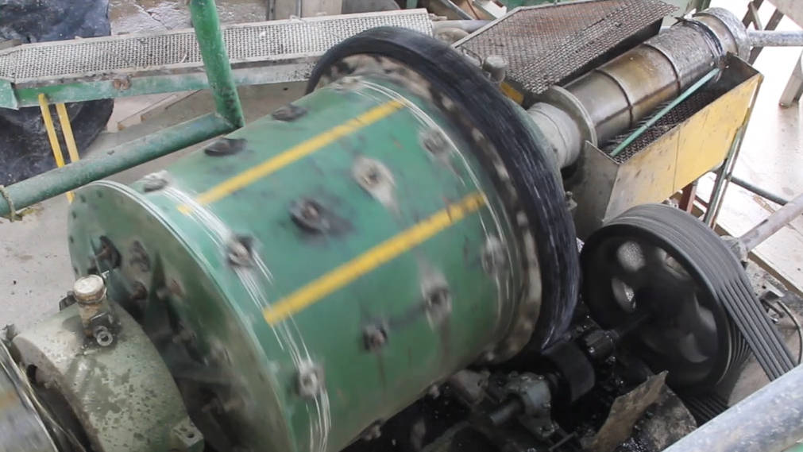
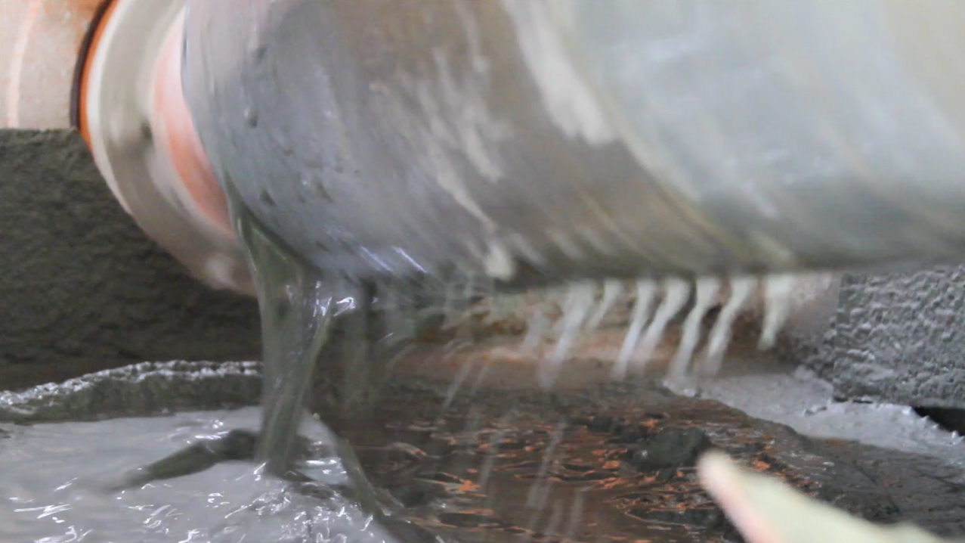
Notes:
This is a series of pictures to use while the presenter explains each piece of equipment to the class in preparation for the exercise.

Slide 27
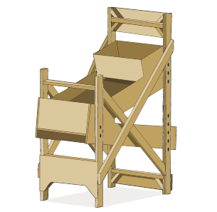
Notes:
This is a series of pictures to use while the presenter explains each piece of equipment to the class in preparation for the exercise.

Slide 28
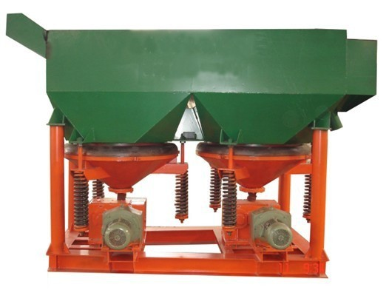
Notes:
This is a series of pictures to use while the presenter explains each piece of equipment to the class in preparation for the exercise.

Slide 29
Notes:
This is a series of pictures to use while the presenter explains each piece of equipment to the class in preparation for the exercise.

Slide 30
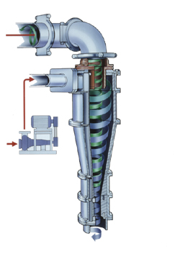
Notes:
This is a series of pictures to use while the presenter explains each piece of equipment to the class in preparation for the exercise.
hydrocyclone

Slide 31
Notes:
This is a series of pictures to use while the presenter explains each piece of equipment to the class in preparation for the exercise.
floatation

Slide 32
Economía
Mejor recuperación de oro
Recuperación de Inversión
Notes:
The final outcome of the exercise is to find out how long it takes to pay back the plant students design with the additional gold recovered by using best practices.
Go through sample calculations with the group to prepare them for the exercise. The presenter should prepare for this by doing several different plant designs on their own to understand how the exercise works.

