Slide 1
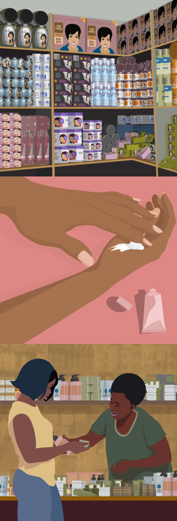
VIRTUAL WORKSHOP ON
MERCURY-ADDED SKIN LIGHTENING PRODUCTS: CUSTOMS & ENFORCEMENT TRAINING
Thank you for joining today’s webinar session!
We will begin shortly.
Kindly note the following guidelines:
Keep microphones OFF unless making an intervention. Cameras are optional.
Use the “Chat” to ask technical questions or share views
The meeting will be recorded, and materials will be shared via email.

Slide 2

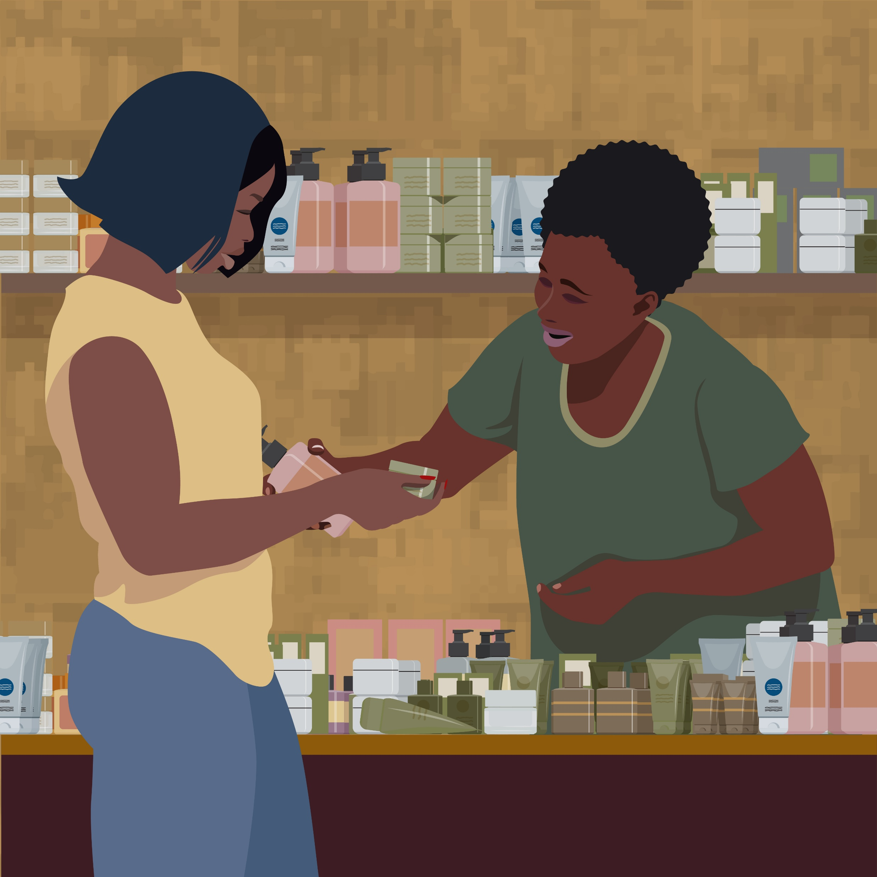

MERCURY-ADDED SKIN LIGHTENING PRODUCTS: CUSTOMS & ENFORCEMENT WORKSHOP - JAMAICA
GEF 10810: Eliminating Mercury Skin Lightening Products (Jamaica, Gabon and Sri Lanka) Project
Monday 30th March 2026
1:00 – 4:00 PM (UTC-5)
held virtually via Zoom

Slide 3
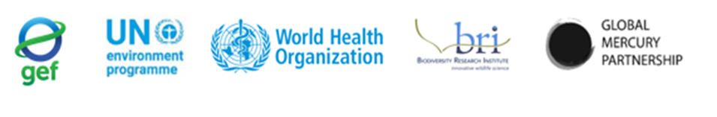


PURPOSE OF TODAY’S SESSION
Under the GEF 10810 Project: Eliminating Mercury Skin Lightening Products
(2022 – 2026), Jamaica, Gabon and Sri Lanka were key countries that were supported in efforts to phase out mercury-added skin lightening products through regulatory and capacity building activities, awareness raising and other measures.
Key Global Project Agencies:
Jamaica Project Focal Points:

Slide 4
Following the outcomes of key project activities including:
Regulatory/Institutional Capacity building for enforcement of Hg SLP bans
Development of a baseline/understanding of the prevalence of Hg SLPs on the national and global market (including online)
Mapping of supply chains for Hg SLP manufacture and trade
A training exercise is recommended to sensitize key stakeholders on guidance that can be adapted to enhance coordination for detecting, monitoring, and preventing the manufacture, import and export of mercury-added SLPs.

Slide 5
Throughout the project, the Government of Jamaica has taken several steps towards elimination of mercury-added skin lightening products (Hg SLPs).
Today’s webinar aims to strengthen the enforcement efforts against Hg SLP trade through knowledge sharing and information exchange with the Jamaica Customs Agency and other key stakeholders related to mercury management in Jamaica.

Slide 6

Overview of the issues posed by mercury-added skin lightening products (Hg SLPs) and measures being taken under the Minamata Convention on Mercury
Findings of rapid sampling exercise in Jamaica
Tools to Enhance Hg SLP Trade Management: HS Codes, Use of Databases and Online Sales Assessments, Analytical Tools
Enforcement Actions for Jamaica
Open Discussion on Needs and Capacities for Enforcement of Bans on Hg SLPs

Slide 7
WHO WE ARE
Biodiversity Research Institute (BRI) is a nonprofit environmental research group based in Portland, Maine, USA.
Mission: To assess emerging threats to wildlife and ecosystems through collaborative research. Scientific findings are used to advance environmental awareness and inform decision makers.
BRI:
Has assisted over 40 countries meet requirements for the Minamata Convention on Mercury.
Conducted Technical Work for 9 Minamata Initial Assessments in the Caribbean, including Jamaica (2017- 2019)
Has analyzed skin lightening products and other media across the globe and provided technical contributions to understanding the issue of mercury in SLPs.
Together with WHO, BRI is co-executing the GEF 10810 Project, “Eliminating Mercury Skin Lightening Products”.

Slide 8

SPEAKERS
Tahlia Ali Shah, BRI
Ashley Bastiansz, BRI
Elena Lymberidi-Settimo, European Environmental Bureau/Zero Mercury Working Group (EEB/ZMWG)
Alicia Smith, Standards and Regulations Division, Ministry of Health and Wellness, Jamaica

Slide 9

OVERVIEW: 1. WHAT IS MERCURY AND WHY IS IT AN ISSUE? 2. THE USE OF MERCURY IN SKIN LIGHTENING PRODUCTS 3. THE MINAMATA CONVENTION ON MERCURY
Tahlia Ali Shah, BRI

Slide 10
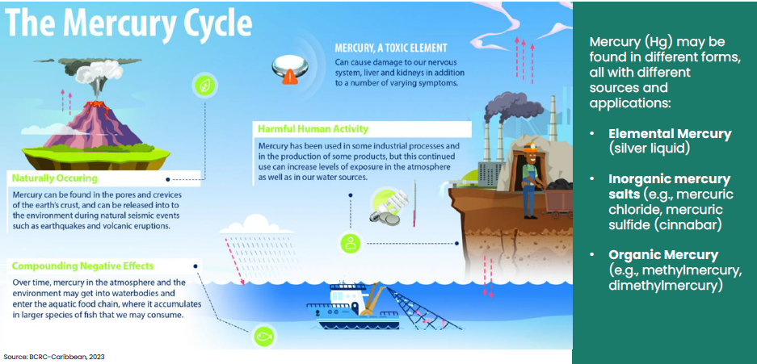

Slide 11
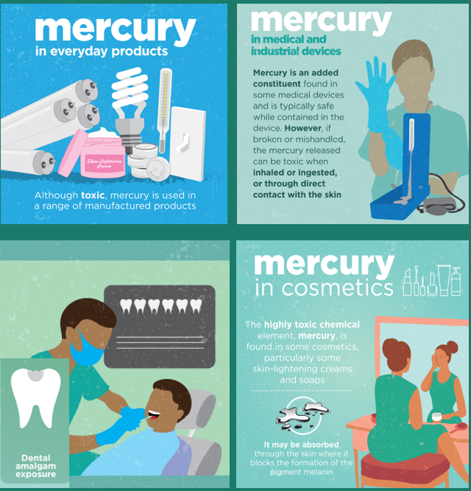

MERCURY ADDED PRODUCTS (MAPs)
Approximately 30% of the global demand for mercury is due to its use in products.
Due to its properties as a good electricity conductor, its high density and high surface tension, mercury has historically been used in many products such as certain:
•Lighting devices (e.g.) CFLs, LFLs and High-pressure mercury vapour lamps
•Batteries
•Electrical Switches and Relays
•Non-electrical measuring devices
•Dental amalgam fillings
•Pesticides, biocides and topical antiseptics
•Cosmetics such as mercury skin lightening products.
Many of these products are being phased out with manufacturing countries phasing out mercury use under the Minamata Convention and other countries agreeing not to import/export them, the long-lasting impacts of mercury releases due to disposal still poses a risk to be addressed.

Slide 12
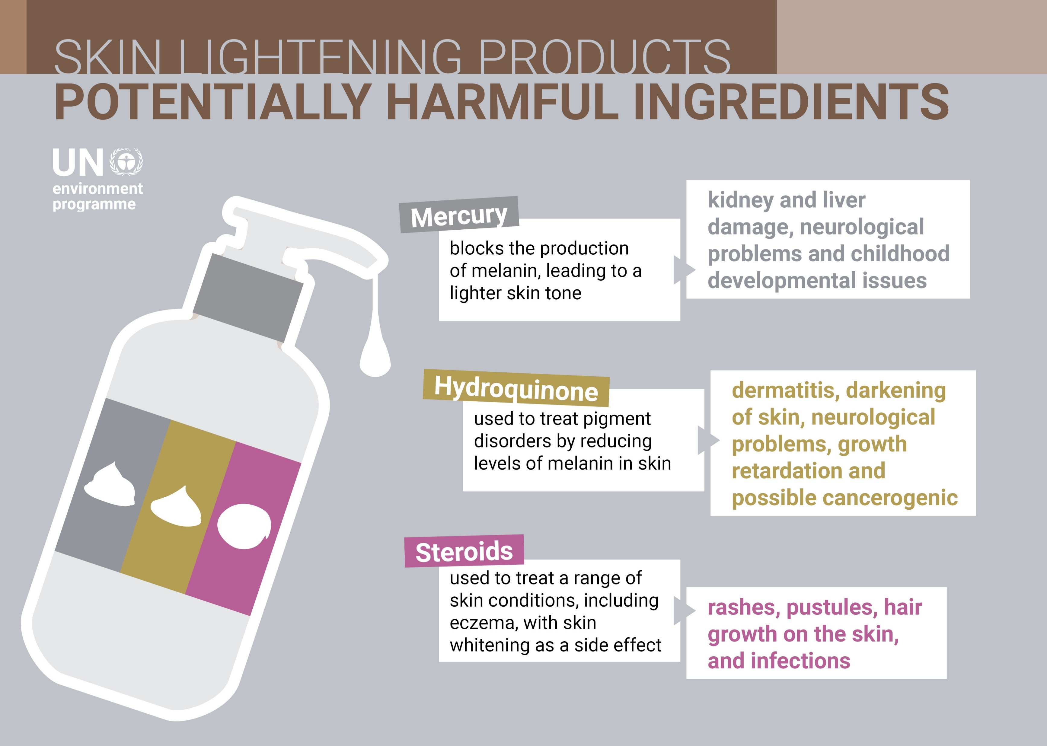
Mercury Compounds Used for Manufacture of Mercury-added Skin Lightening Products:
Mercury(I) chloride
Mercury(II) oxide
Mercury(II) amidochloride (ammoniated mercury) - most popular Hg compound reported in Hg SLPs.
NOTE: There are very few Hg SLPs on the market that actually list mercury/mercury compounds as ingredients (despite having them in very high concentrations).

Slide 13
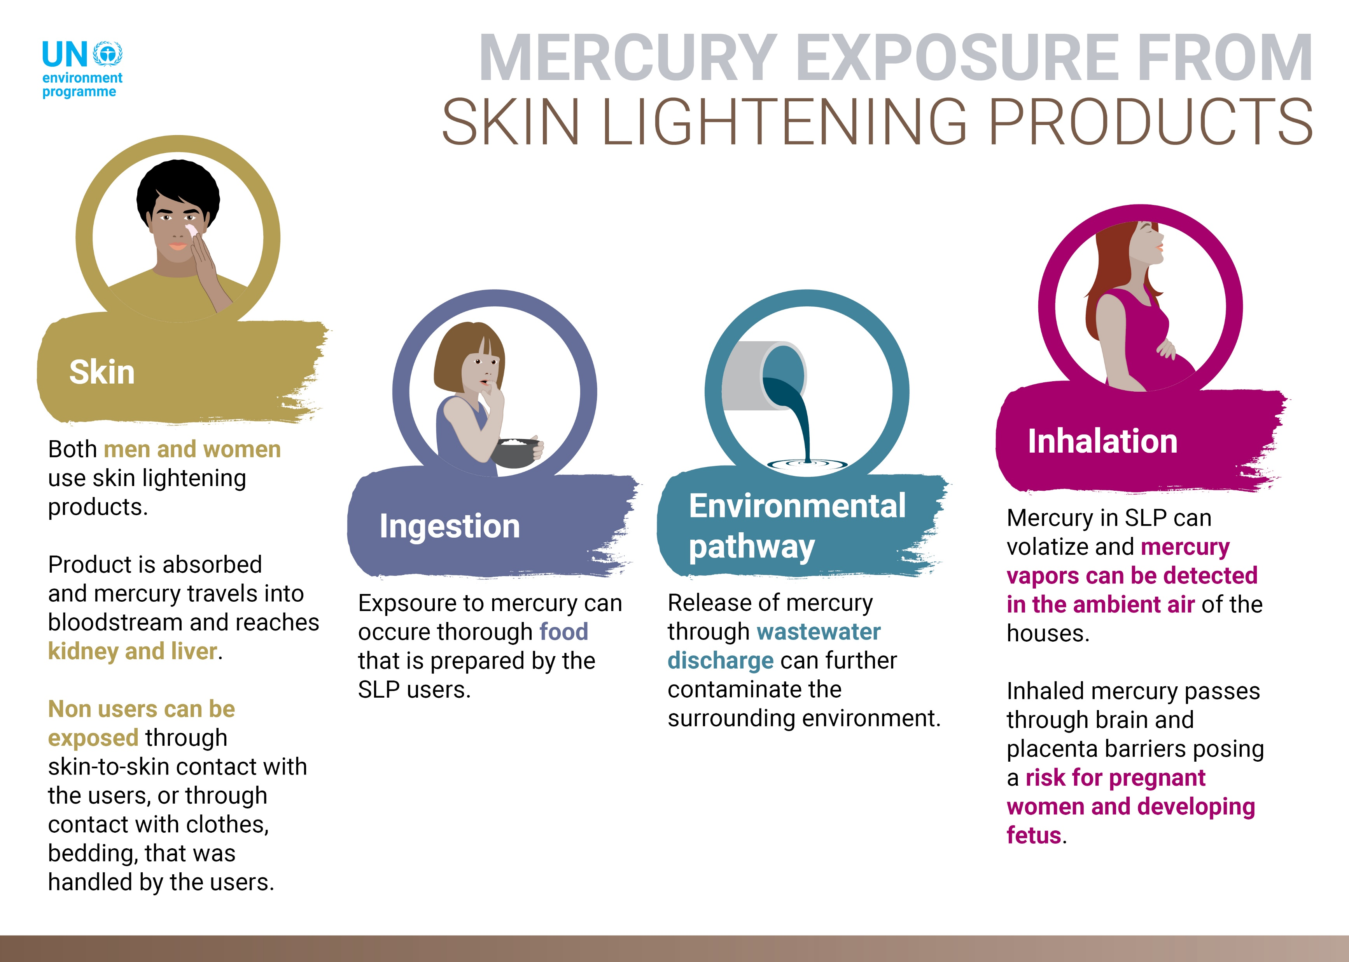
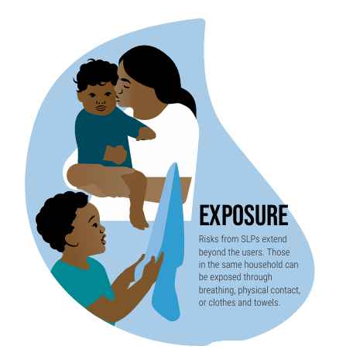

Slide 14
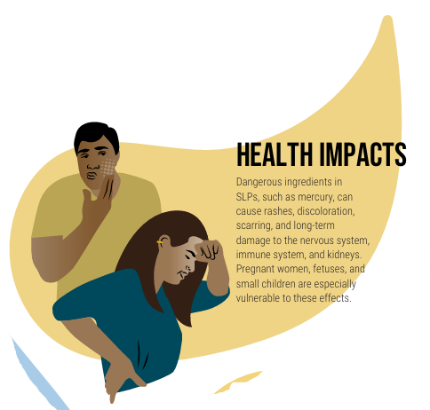
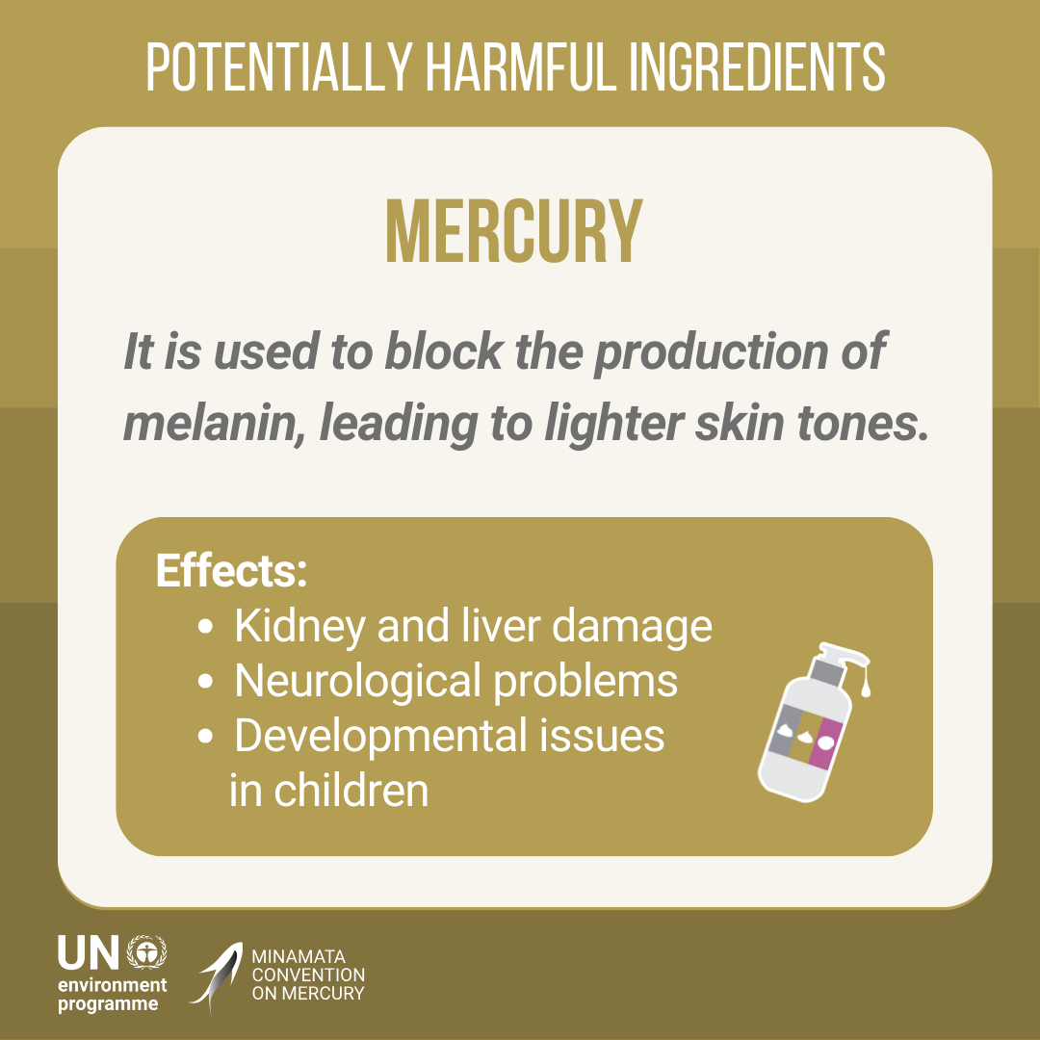

Slide 15
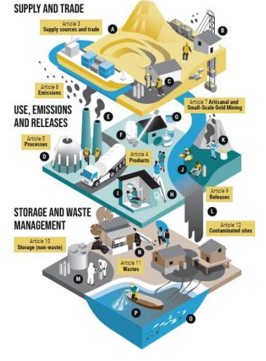

The Minamata Convention on Mercury
A global environmental treaty that aims to protect human health and the environment from the anthropogenic emissions and releases of mercury.
Effective since August 2017
153 Parties to date, including the Government of Jamaica
Comprised of several technical and administrative articles (obligations) for Parties

Slide 16
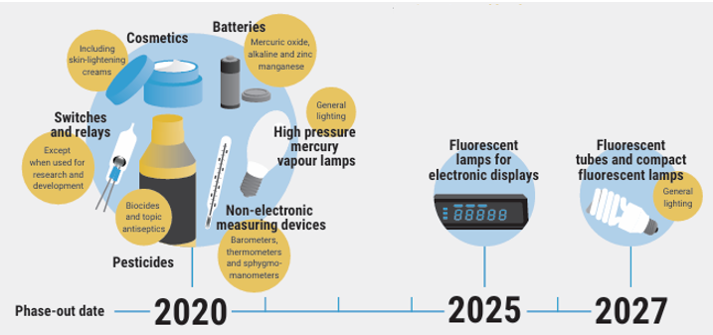
Requires Parties to phase out manufacture, import and export of mercury added products listed under Annex A (Part 1) and Phase Down products listed in Annex A (Part 2).
Article 4
Mercury Added Products

Slide 17
The original text stated that Parties shall not allow the manufacture, import or export of:
“Cosmetics (with mercury content above 1 part per million (ppm)), including skin lightening soaps and creams….”
As of 2023, the “1 ppm limit” was removed – does not cover soaps or creams with trace contaminants of mercury.
Cosmetics
with mercury
Under the Minamata Convention

Slide 18
At the recent Conference of the Parties of the Minamata Convention on Mercury, Decision MC-6/4: Advancing work related to mercury added cosmetics was taken.
This decision encouraged Parties and Partners to undertake further work to better understand the challenges and develop solutions to phasing out mercury-added cosmetics.
Cosmetics
with mercury
Under the Minamata Convention

Slide 19
Included among other things:
Encouraging Parties and partners to collect and report on challenges in preventing the manufacture, import and export of mercury-added cosmetics, including enforcement challenges, and to report on the matter to the Conference of the Parties at its seventh meeting (2027);
The Secretariat cooperates with INTERPOL, World Customs Organization and UN Office of Drugs and Crime on broader issues of illegal, informal and illicit supply and trade including elemental mercury, mercury-added products and mercury waste.
Decision MC-6/4: Advancing work related to mercury added cosmetics

Slide 20
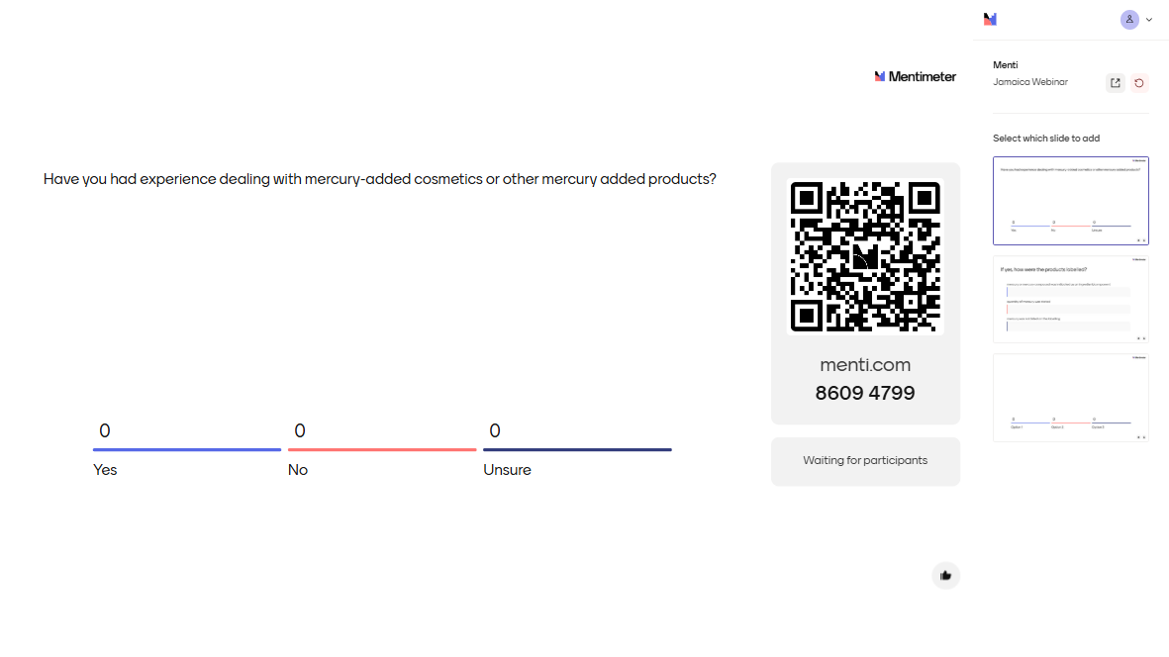

Slide 21
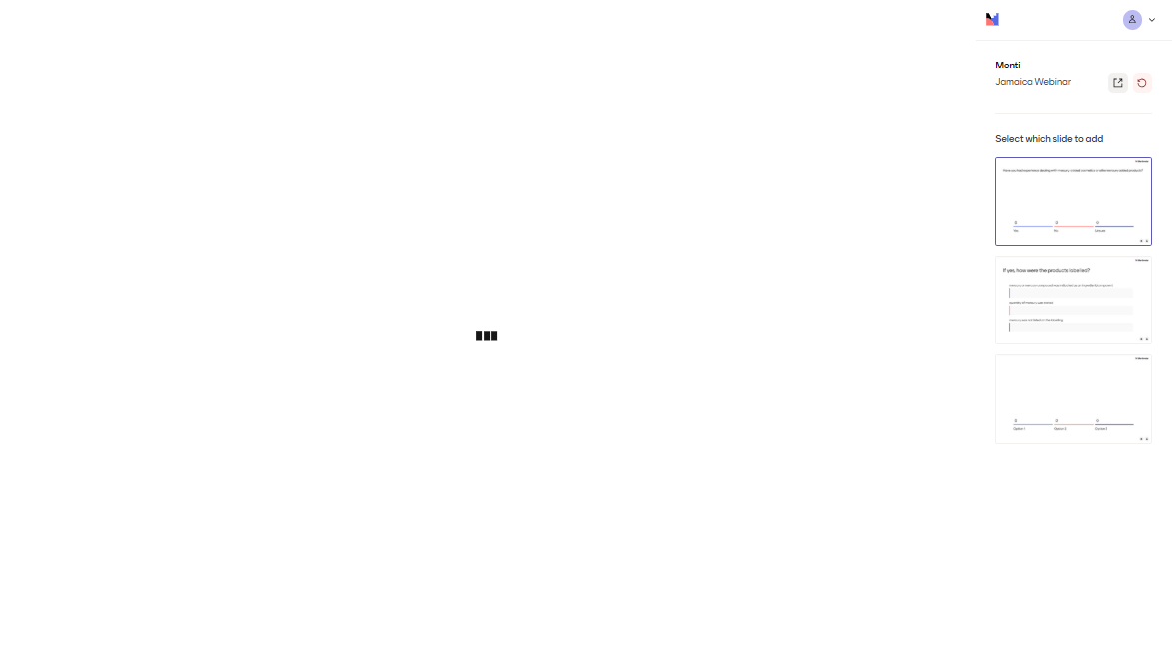

Slide 22
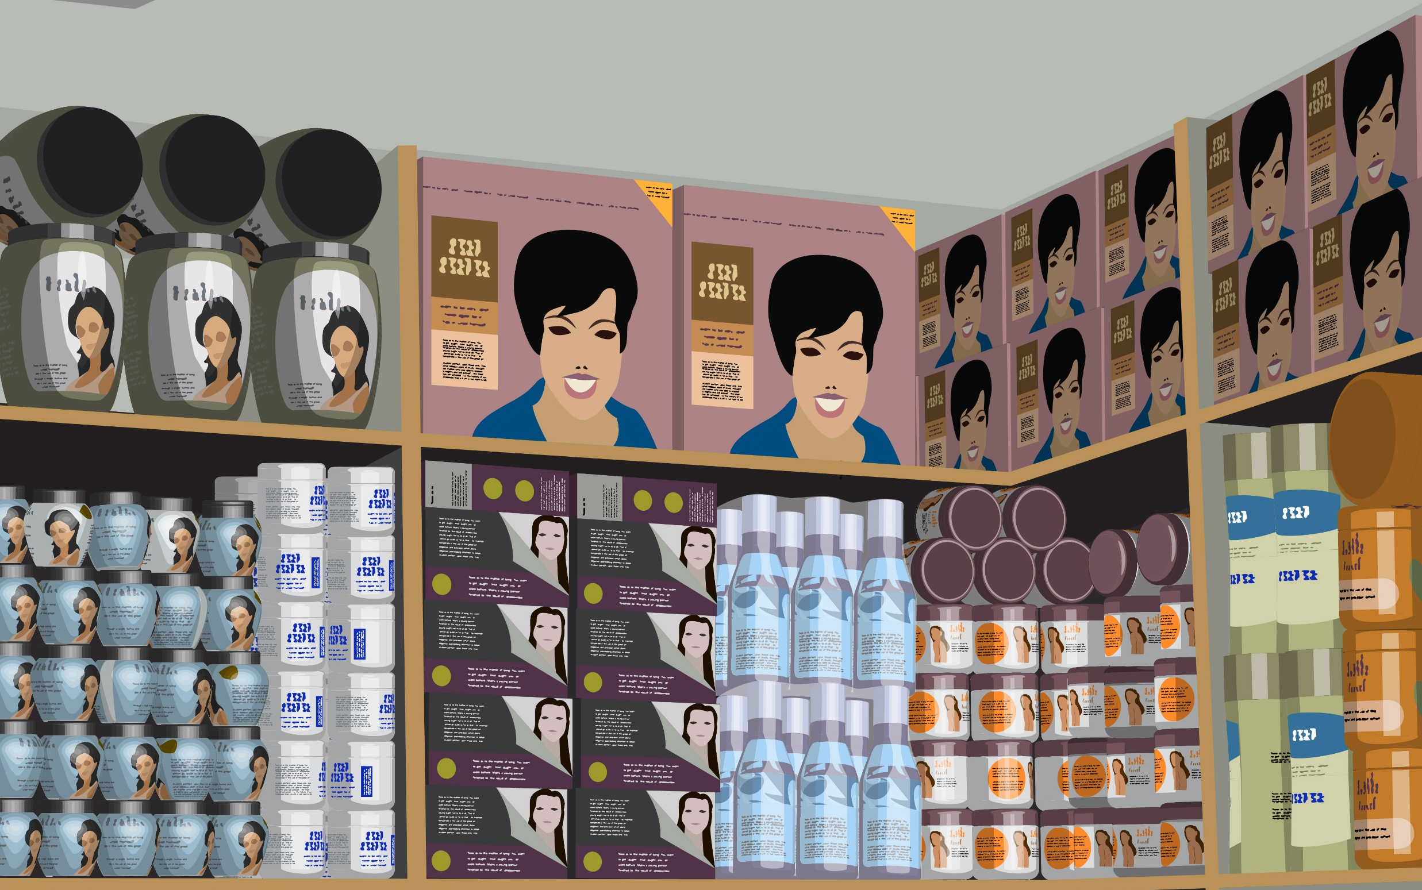
FINDINGS OF RAPID SAMPLING EXERCISE IN JAMAICA
Conducted between 2023 – 2025 under the GEF 10810 Project
Tahlia Ali Shah, BRI

Slide 23
Mercury-added skin lightening products (Hg SLPs) are often difficult to identify due to factors such as:
improper/lack of labelling on products
inconsistency in mercury concentrations amongst batches of products, etc.
To better understand the prevalence of Hg SLPs on national markets, a sampling and analysis protocol was developed for testing under this project.
All 3 project countries undertook a rapid sampling exercise. All samples were analyzed by BRI’s lab located in Maine, USA to ensure a consistent analytical approach across project countries.
For national capacity-building, recommended local labs were also engaged to conduct duplicate testing of samples. The comparison and review of results from both BRI’s lab and national labs enhances the quality assurance and quality control of results published.

Slide 24
MARKET SURVEY
A purposive sampling protocol was carried out where samples were selected for sampling based on:
Availability in capital city/port cities
Products sold in formal retail stores as well as informally in local markets
Products that had key labelling/advertising words such as “bleaching”, “lightening”, “brightening” etc.
Products were purchased by the project team as incognito “customers” rather than as official surveyers to prevent bias from sellers.

Slide 25
MARKET SURVEY
In June 2024, Phase 1A sampling activities took place in Jamaica with 52 products being collected in Kingston.
In April 2025, Phase 1B sampling activities took place in Jamaica with 31 products being collected in Montego Bay.
82 different products were purchased with an additional duplicate of 1 product.
*It is noted that the sampling exercise may not be able to capture the full availability of Hg SLPs on the national market but can provide insight into the trends observed and focus areas for further market surveillance by national authorities.

Slide 26

PHASE 1 ANALYSIS
Each sample collected under Phase 1 was split so that each product could be tested by BRI and ICENS using:
X-ray Fluorescence Analyzers (XRF): for rapid screening to guide on mercury concentration ranges
Direct Mercury Analyzers (DMA): to determine accurate mercury concentrations
This ensured quality assurance/quality control of results on mercury concentrations in each product sampled.

Slide 27
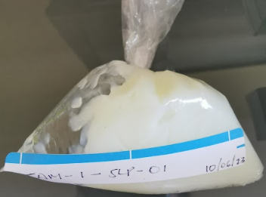
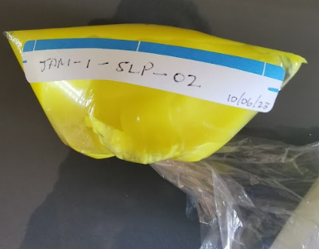
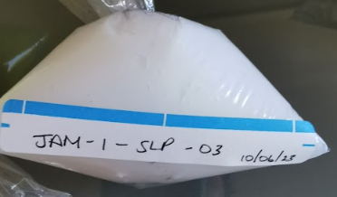
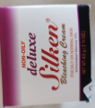
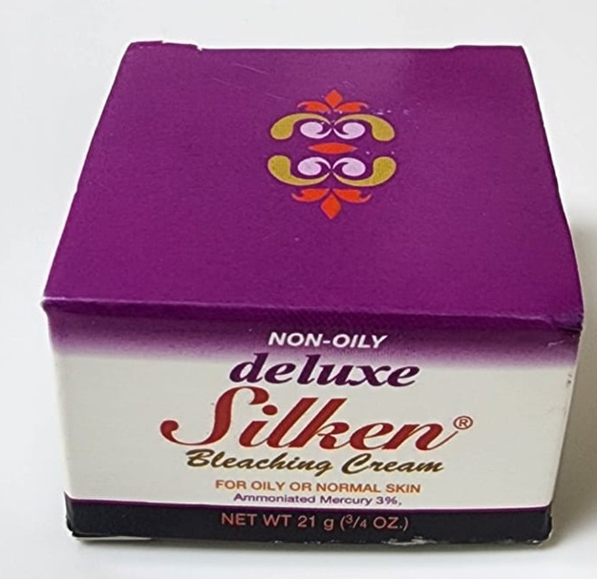
Photo | Name of Product | Batch Number | Purchase Location | Hg Range* (ppm)
 | unlabelled cream (vendor identified as Nadinola) | n/a | Downtown Kingston (homemade mixture from street vendor) | 225 - 892
 | unlabelled cream (vendor identified as yellow Nadinola) | n/a | Downtown Kingston (homemade mixture from street vendor) | 200- 2,521
 | unlabelled cream (white-coloured) | n/a | Downtown Kingston (homemade mixture from street vendor) | 106 – 1,268
 | Silken Bleaching Cream - non-oily deluxe, Ammoniated Mercury 3% | o009 | Kingston (formal retail store) | 16,545 – 18,371
 |  | Q019 | Montego Bay (formal retail store) | 5,191- 7,538

Slide 28
JAMAICA FINDINGS
Of the 82 products analyzed:
~5% were confirmed to have elevated mercury concentrations (> 1 ppm):
1 formally manufactured in Jamaica (concentrations up to 16,545 ppm)
the remainder were informally mixed and sold by vendors in Jamaica.
~ 77% were below the limit of detection for DMA analysis
~ 18% indicated concentrations between 0.001 – 1.00 ppm (possibly due to unintentional mercury contamination)

Slide 29
RESULTS OF SAMPLING ANALYSIS FOR ALL PROJECT COUNTRIES (JAMAICA, GABON AND SRI LANKA)
459 SLPs (not including duplicate samples) were analyzed from the 3 project countries.
~ 10% were found with elevated Hg
Range of concentrations were from ~100 to > 41,000 ppm
60% of Hg SLPs were listed as being manufactured in Pakistan
Others were listed as being manufactured in India, Sri Lanka, Malaysia, Thailand, China, Turkiye, Egypt, France, Jamaica or were unknown.

Slide 30
SOURCE OF MERCURY COMPOUNDS FOR Hg SLPs
A 2023 investigation conducted by Environmental Investigation Agency (EIA) indicated that for Hg SLPs manufactured in Thailand, Pakistan and Jamaica, mercury compounds were imported by manufacturers from India, Spain and the USA.
Determining how these compounds were able to be exported/imported still has to be assessed but demonstrates the need for enhancement of border controls and regulations.
Findings from the analysis conducted under the GEF 10810 project will be made available via an online global database and other resources in early 2026.

Slide 31
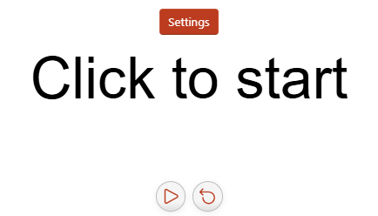
VIRTUAL WORKSHOP ON MERCURY-ADDED SKIN LIGHTENING PRODUCTS: CUSTOMS & ENFORCEMENT TRAINING
*5-minute health break*

Slide 32
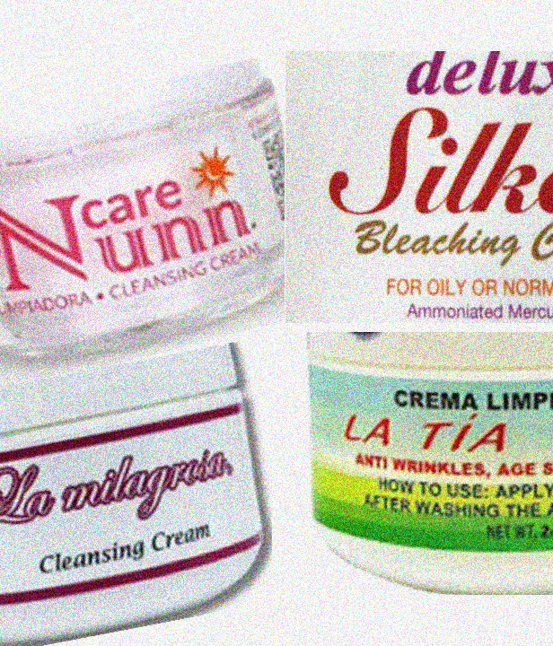


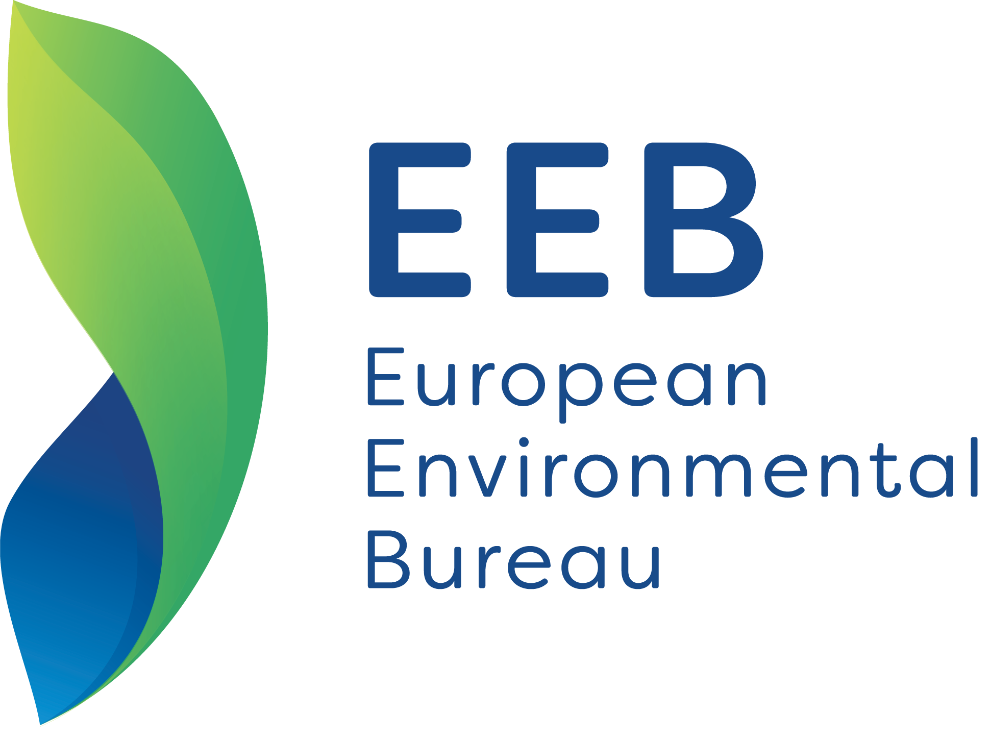
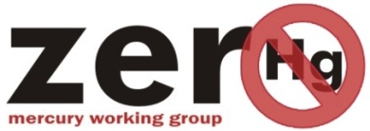
Trends observed in online sales assessments of SLPs and recommendations
Customs Training to Enhance Monitoring of Trade of Mercury, Mercury Compounds and Mercury-added Skin Lightening Products
30 March 2026
Online meeting, Jamaica
Elena Lymberidi-Settimo, European Environmental Bureau
Michael Bender, Mercury Policy Project
International Co-coordinators Zero Mercury Working Group
UNEP GMP Products Area co-leads
Notes:
Thank you once more for the invitation to share our work and experiences.
To shortly present ourselves,

Slide 33

ZMWG and Hg/Skin Lightening Products Campaign Partners
Europe’s largest network > 180 NGOs > more than 40 European countries > 30 million members and supporters.
Vision: A better future where people and nature thrive together
> 55
Countries
2005
ZMWG creation
> 110
Member organisations
Aim: Reduce/eliminate mercury supply, use, emissions, exposure, and support implementing the Minamata Convention on Mercury
AFRICA- Bio Vision Africa, Uganda; Center for Environment Justice and Development, Kenya; Centre Africain pour la Santé Environnementale, Cote d’Ivoire; groundWork, South Africa; Sustainable Research and Action for Environmental Development, Nigeria
AMERICAS- Casa Cem, Mexico; Mercury Policy Project & WE-ACT, United States; Integrated Health Outreach (IHO), Antigua and Barbuda; Toxisphera Environmental Health Association, Brazil
ASIA- BAN Toxics, the Philippines; Center for Public Health and Environment, Nepal; Earth, Thailand; Environmental and Social Development Organization, Bangladesh; NEXUS3Foundation, Indonesia; Toxics Link, India
EUROPE- European Environmental Bureau, Belgium
Notes:
European Environmental Bureau the largest NGO network in Europe with over 180 members from 40 countries and I have been leading the EEB on the mercury for over 20 years. JE MENE LE TRAVAIL SUR LE MERCURE POUR PLUS DES 20 ANS
Together with the Mercury Policy Project , a US based NGO, back in 2005, we launched the Zero Mercury working group – and I have been co-coordinating it since then.
ZMWG - of more than 110 public interest, environmental and health NGOs from over 55 countries from around the world. We aim to address mercury pollution and exposure, implementing the Minamata Convention
Beyond following the work that led to the convention, we have been supporting the work of developing country ngos and governemtns on several issues, such as phasing out mercury added products including skin lightening creams.
Under the ZMWG skin lightening creams campaign which was launched in 2017, we have been cooperating with many ngo partners from around the world and we would like to thank them for their input and contributions along those years - here you can see the partners from the last sampling round.

Slide 34


Investigating online sales of Hg/SWPs
Under the project, EEB/ZMWG has been hired by WHO to contribute to existing knowledge about online marketing of skin whitening products (SWPs) in each of the three project countries, Gabon, Jamaica, and Sri Lanka, and suggest mechanisms for addressing this issue by:
Identifying Hg/SWPs available online in 3 countries and assessing relevant info.
Understanding the magnitude and proportion of online sales w/and without mercury.
Providing information on existing controls for controlling online sales of illegal consumer products
Documenting success stories that can benefit and potentially apply in project countries in their endeavours on controlling and regulating relevant online sales;
Developing methodologies that could be used to affect changes in online marketing practices;
Assisting countries in engaging online marketplaces in enforcing their prohibited product policies
Notes:
Under this UNEP led , WHO/BRI executed project , we have a contract with WHO and we will be carrying out a component related to SLPs and online sales.
We will be identifying SLPs available on the online markeplaces in the three project countries Gabon, Jamaica and Sri Lanka, and try to get a better understanding on the magnitude of online sales of SLPs.
We will also try to share experiences which can benefit the countries towards tackling online sales of Hg/SLPs.
During this presentation I will be presenting our findings based on our research and experiences in the recent years and some recent developments from the ongoing work in Sri lanka.

Slide 35
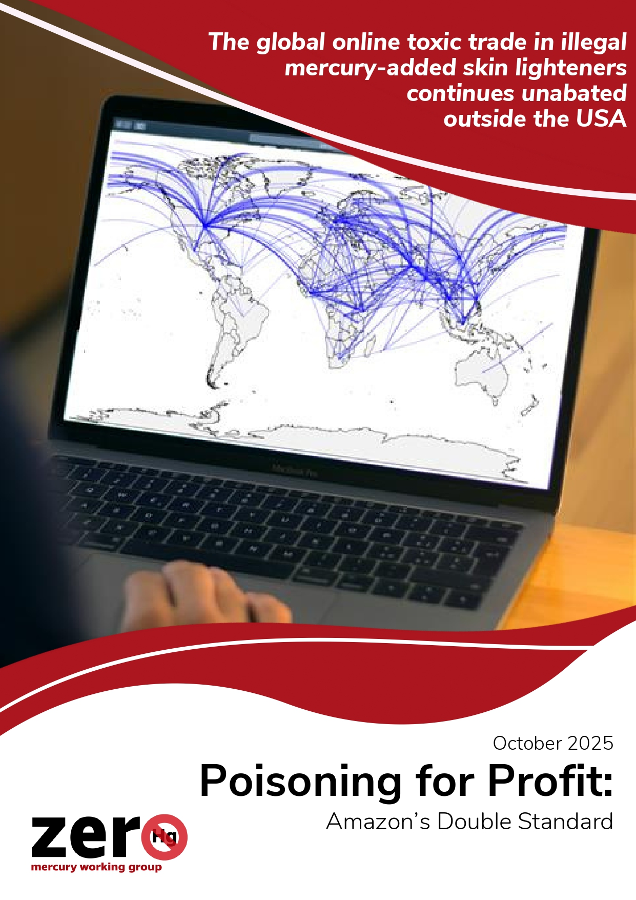
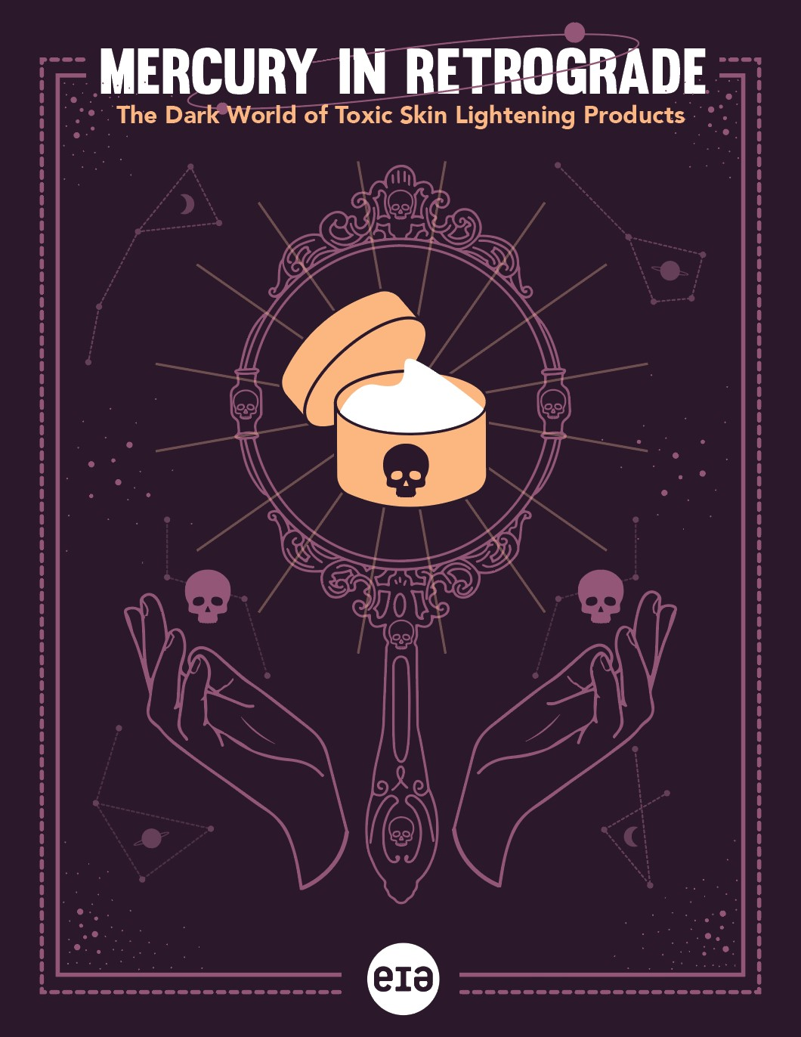
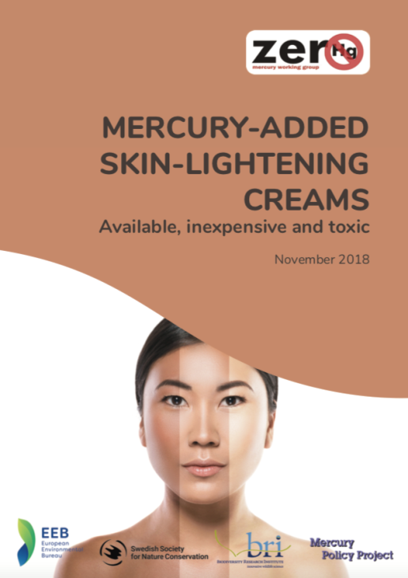
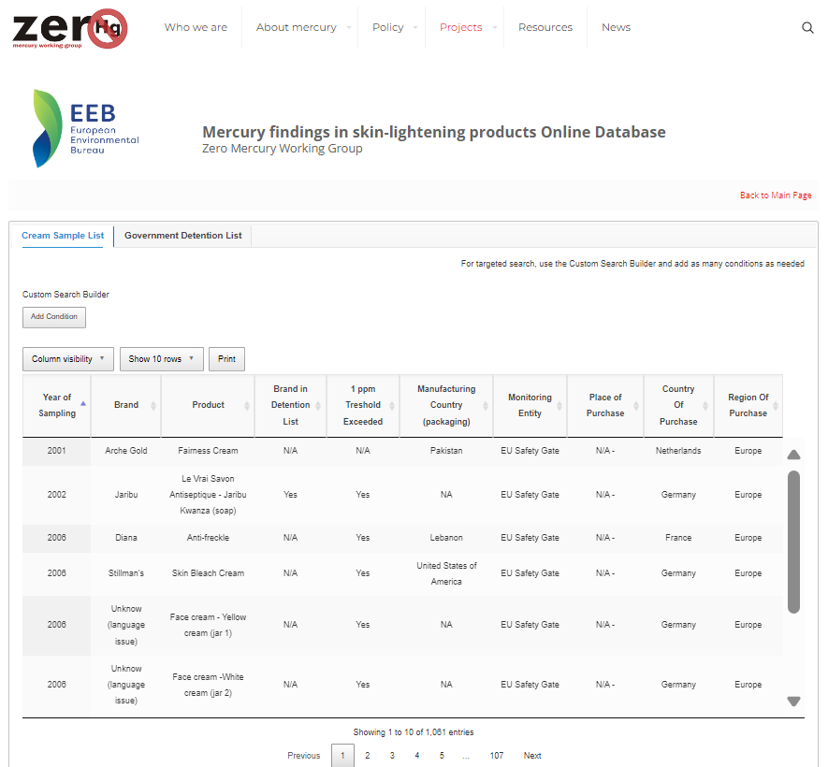
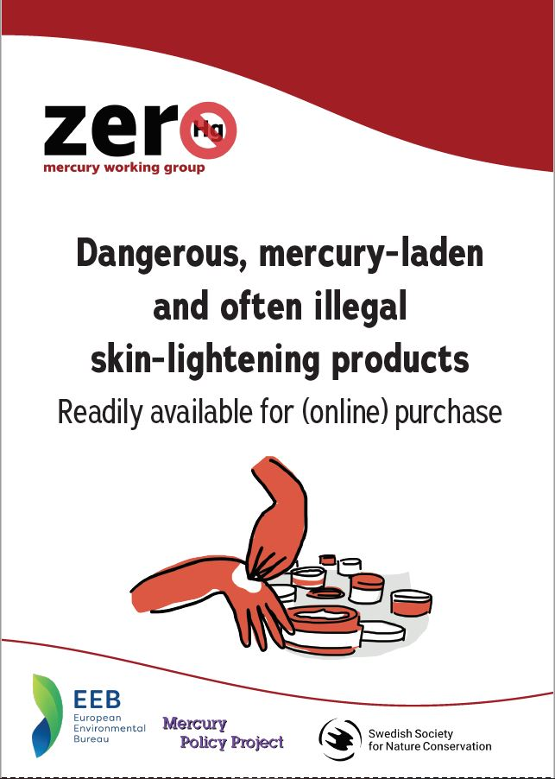
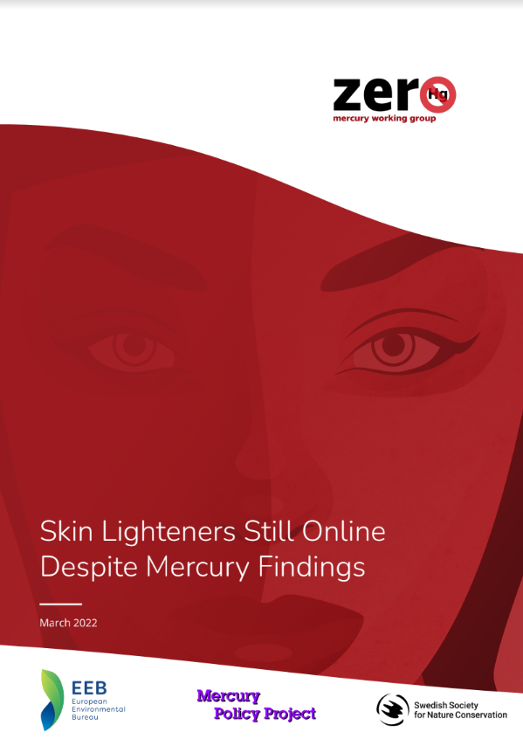
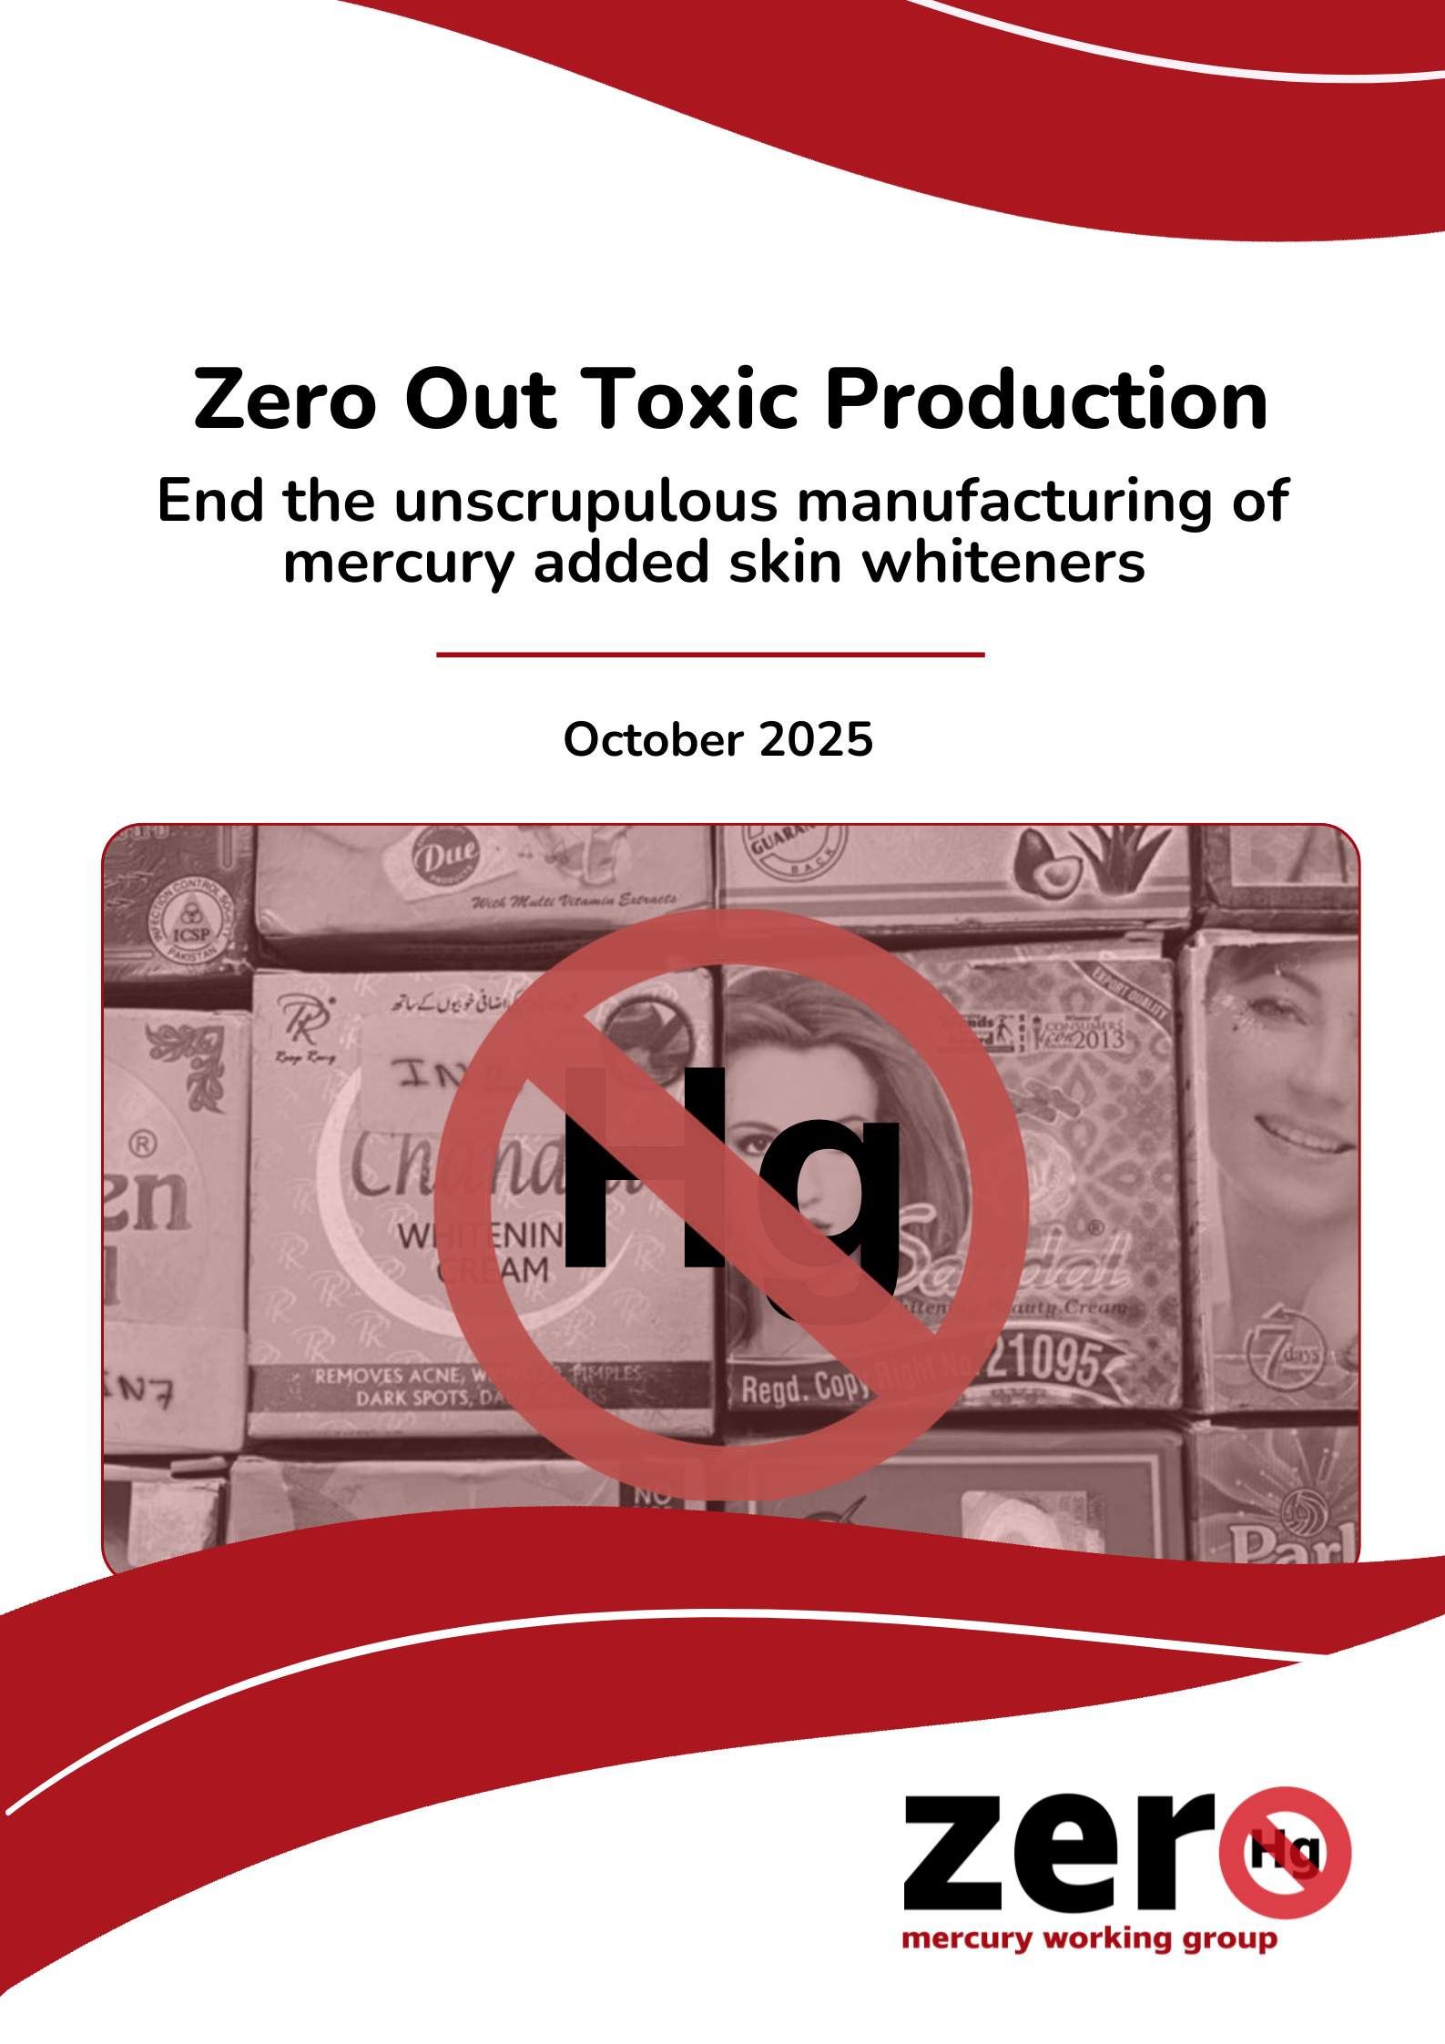
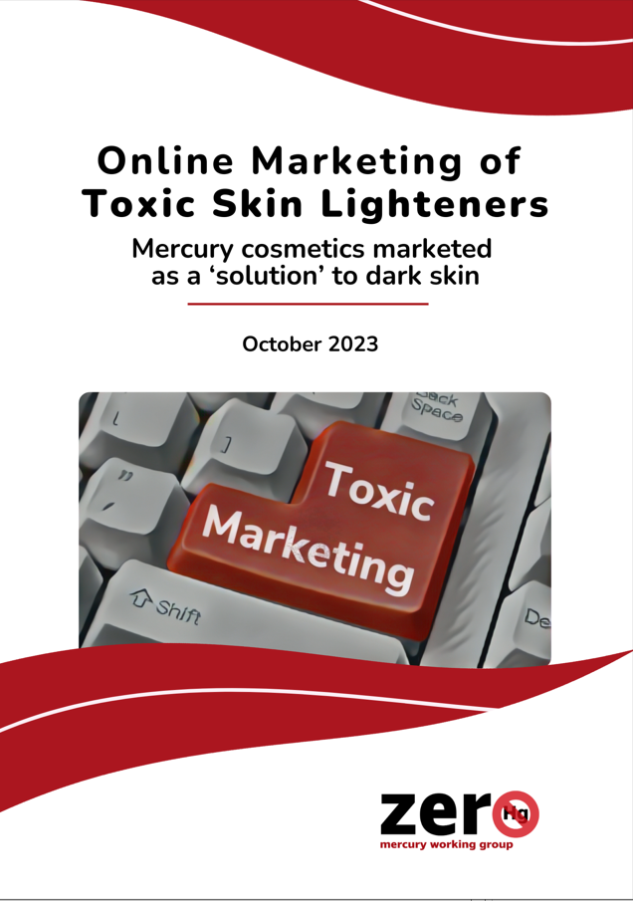
Evidence Gathered by the ZMWG Campaign
EIA investigation 2023
Mercury compounds added in SLPs
Production in Thailand, Jamaica, and Pakistan
Intermediary transit ports in Spain, UAE, and USA.
Global samplings 2017- 2018, 2019, 2022, 2023, 2025
Main focus on online platforms’ sales
Over 1000 products tested, engaging multiple NGO partners from around the globe
From over 40 platforms
Over 70 brands found with mercury above 1ppm.
ZMWG Database https://www.zeromercury.org/projects/mercury-added-skin-lightening-creams-campaign-database/

Slide 36
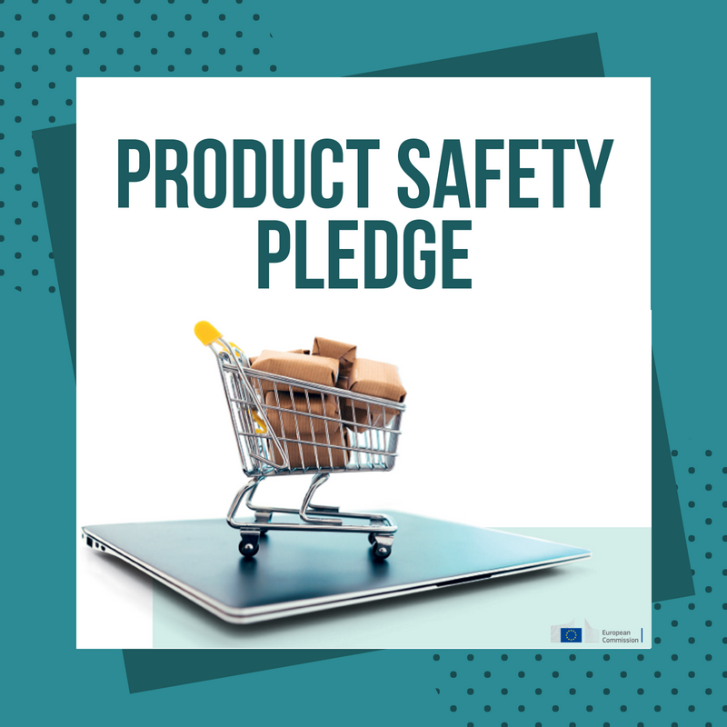
Elements for effective enforcement
Regulations (e.g. on manufacture, trade, sale labelling, compounds, online services)
Data collection (e.g. sources, screening techniques XRF, etc, labs)
Advisories, Prohibited products lists (e.g. national/regional detention lists or advisories, alert systems)
Raising Awareness (e.g. inform regulators, health professionals, consumers, academia, CSOs)
Intergovernmental and Interregional cooperation (e.g. defined responsibilities, coordination, police, customs, harmonization of laws, alert systems etc)
Licensing of manufacturers and product ingredient approvals
Enforcement /Inspections (e.g. clear mandates, responsibilities, formalized inspections, capacity building)
Online commerce and voluntary agreements or product safety pledges (PSP) (e.g. regulations- sales bans, voluntary agreements , product safety pledges etc.)
Penalties and sanctions
Advertising / Display and Marketing
Notes:
Given the extend of the problem it is clear that attention needs to be put on the enforcement and all that comes along with that which covers the whole supply chain. Attention was drawn to that from the African Region at the last 2 COPs.
And As we heard earlier this led to the COP6 inviting the Secretariat in cooperation with international partners to continue looking at the challenges and measures and assist ,to better enforce the mercury ban on cosmetics.
The Secretariat is invited to provide COP-7 with information on mechanisms that support enforcement and on methods for identifying mercury in cosmetics, as well as to collaborate with the World Customs Organization and INTERPOL to investigate sources of illegal mercury trade. The decision further enhanced the relations with the World Health Organisation (WHO); in cooperation with the partners and the GMP, WHO is invited to share lessons learned from its relevant ongoing projects and to prepare an illustrative national public health system-wide strategy, focused on reduction measures for mercury added cosmetics. It is noted that skin lightening products that may not contain mercury are also to be part of this strategy -in an effort to tackle colorism.
Looking at the areas that need to be considered
first is the legislative framework that needs to put in place and consider a wider set of elements such as manufacture(as first priority), trade, sale, labelling, online services etc)
Information sharing, detention lists and advisories would be very important to be developed as they serve as tools to enforce the legislation and other agreements
Licensing and approval of ingredients used- is another set of measures that needs to be looked at and that also refers to the supply chain overall.
For all these to happen , obviously the enforcement and inspections would need to be strengthened ; clear responsibilities allocated, inspection programme formalized,
penalties and sanctions built into the system and respected
As well as elements related to advertising and display.
Furthermore,
Data will need to be collected , sampling on the ground and online markets, and ensuring that instruments are available for screening supported by lab analysis as relevant.
At the same time Awareness raising is important – initiatives would be necessary to inform consumers, but also platforms, sellers etc, collaboration with academia, dermatologists and CSOs would be highly relevant. Also education and awareness raising should rather start from the bottom/ the schools – the teachers, the professionals – only in that way we can go towards a shift of mentality in society – while top down measures are being considered.
Very important is the intergovernmental and interregional cooperation . First it is important to identify and involve all the right agencies WITHIN the country. Min env, health , customs, police
And look at our neighbouring countries, the interregional cooperation will have an important role to play as products pass through porous borders.
There are examples which exist in the ASEAN, Easet African Community etc
As per our reports, controlling online platforms via sales bans and/or voluntary agreements is another major challenge. But lets look into that a bit more.

Slide 37

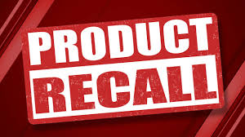
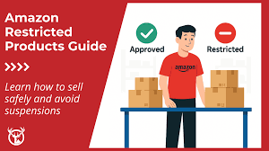
Controlling online sales
Ban sales and offering of sales
Clear liability rules to be established and enforced, with significant penalties
E-commerce platforms :
need to assume liability
must ensure that the sellers comply with domestic health and safety law (correct labelling, disclosure of ingredients etc)
should verify foreign third-party sellers and appoint a home-country legal representative
Most online marketplaces have prohibitive product policies in place
Important to bring the platforms on the table
Notes:
While manufacturing countries need to step up and enforce the mercury ban, Online sales are amplifying the number of overall sales and eventually exposure risks of Hg SLPs.
To best target online platforms the easiest would be:
to include in law banning of sales and offering of sales – This gives you the tools to hold online platforms liable in case they sell and allow putting, SLPs that are banned by law – because they contain for example mercury.
Then the implementation and enforcement of the law matters.
Clear liability rules need to be established and enforced with significant penalties
E-commerce platforms
need to assume liability
must ensure that the sellers comply with domestic health and safety law (correct labelling, disclosure of ingredients etc)
should verify foreign third-party sellers and appoint a home-country legal representative
At the same time, Most online marketplaces have prohibitive product policies in place
To that end it would be important to bring the platforms on the table and discuss with them, to agree on their efforts

Slide 38
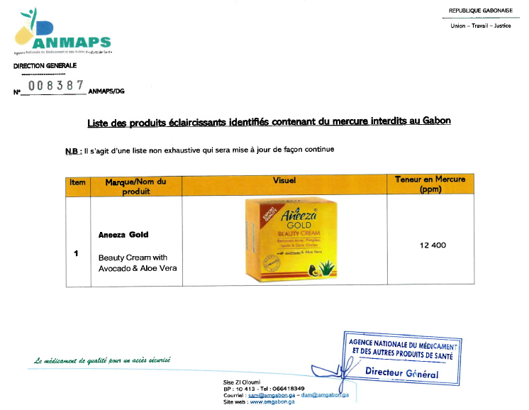
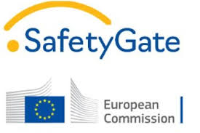

Prohibited products lists –key words
Prohibited products lists
African countries (e.g. Kenya, Uganda, Gabon)
EU Safety Gate / OECD Global Portal
ASEAN
ZMWG database
Important to update them
Customs/market surveillance and online surveillance authorities need to also look for key words – traders try to escape algorithms:
Lightening
Whitening
Bleaching
Brightening
Spot removal

Slide 39

Key elements of Voluntary Product Safety Pledges
Local or designated contact
Marketplaces monitor regularly government recall/detention lists
Products removed within two days in the EU, after government/website notifications
Trusted flagger system in place
Information and training activities to sellers.
Improvement in identification of similar listings
Using of new technologies - AI image algorithms and image recognition tools, etc.
Progress in allowing consumer groups to signal product safety concerns.
EU product safety pledge (since 2018), voluntary actions in 20 areas, some beyond legislation.
11 online marketplaces
reporting every 6m on fulfilling measures
Several governments now have pledges: Australia (2020), S. Korea (2021), Japan (2023), Canada (2023), UAE(2024) and India (2024).
Initially, a narrower scope for a VA with platforms may be preferable
Notes:
To go back on how to tackle online sales , apart from the regulatory approach it would also be important to consider voluntary approaches which can complement regulatory measures which are already in place.
An example of voluntary approaches are product safety pledges,
Products safety pledges are agreements platforms sign with a government.
For example, the first Product Safety Pledge was developed in the EU in 2018 and has now been revised. It covers 20 areas and some elements go beyond legislation. 11 online marketplaces have now signed the EU one and are reporting to the COM every 6 months.
Several other governments have followed this approach e.g. … box
These safety pledges can include elements such as …slide you don’t need to mention all.
IMPORTANT : Governments can choose the scope of their voluntary agreement , and in the case of SLPs it may be best to start from cosmetics and then expand to other areas as relevant.

Slide 40

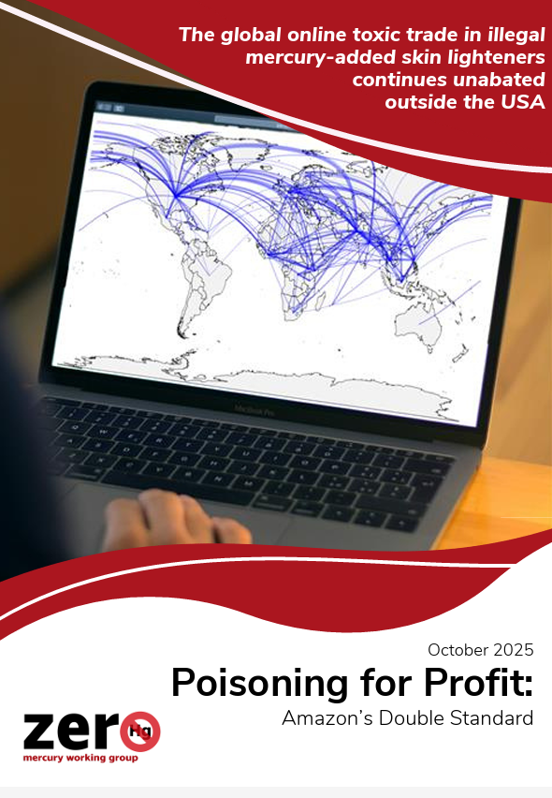
Case study: US State of California Attorney General settlement with Amazon.com on sale of mercury-added skin lighteners
Nearly 600K USD settlement resolving Proposition 65 and Unfair Competition law
Starting in October 2024, Third Party Sellers must have SLPs tested for Hg and other hazardous substances and verified through Amazon approved accredited labs.
Required compliance includes: SWP label verification; good manufacturing practice certificate; facility registration and product listing; and product testing
Bans sales of products subject to recalls, market withdrawals, stop sales requests
ZMWG 2025 Report
Amazon’s double standard
Suspect SLPs from different Amazon websites sampled by ZMWG partners
31 creams purchased, 25 SLPs with mercury
Few Hg/SLPs on U.S. website
Amazon’s websites in Mexico, UAE, India still offering many high Hg/SLPs
Outside the US, Amazon continues to poison for profit particularly in Global South
Notes:
Case study: Amazon.com settles after not warning consumers on potential cancerogenic effects of SLPs (as they were found with mercury)
It is also worth noting that Amazon.com was taken to court by the California Attorney General’s office, under the state’s Proposition 65 and its Unfair Competition Law, as they were selling mercury added creams, without warning the consumer that these could potentially be cancerogenic.
After reaching a settlement, Amazon.com, changed their policy asking all sellers to have tested their skin lightening products for mercury and other hazardous substances, with those being verified through Amazon approved accredited labs, before they would be allowed to make them available on their platform.
Settlement ensures that consumers won’t be exposed to mercury in skin lightening and brightening creams they buy on Amazon.com
As a follow up to this case , ZMWG published in October a report looking at Amazon’ - short mention
Plaintiffs Larry Lee and As You Sow reached a settlement with Amazon concluding a nearly decade-long lawsuit addressing the sale on Amazon.com of brightening and lightening skin creams containing mercury. The plaintiffs partnered with California’s Attorney General, which filed its own lawsuit under Proposition 65 and California’s Unfair Competition Law.
Amazon will pay nearly $600,000 in civil penalties, attorneys’ fees, and costs to the AG, and will agree to injunctive provisions aimed at preventing creams with high mercury levels from being sold through Amazon’s website into California.
Starting in October 2024, sellers must have SLPs tested for Hg and other hazardous substances and verified through Amazon approved accredited labs.
Required SLP compliance includes: label verification; good manufacturing practice certificate; facility registration and product listing; and product testing
Bans sales of products subject to recalls, market withdrawals, stop sales requests
Settlement ensures that consumers won’t be exposed to mercury in skin lightening and brightening creams they buy on Amazon.com.”
To that end one would need to ask and check if the country has any online related regulations, or policies , and what do those cover.
It would be important to find out , what applies for cosmetics.

Slide 41


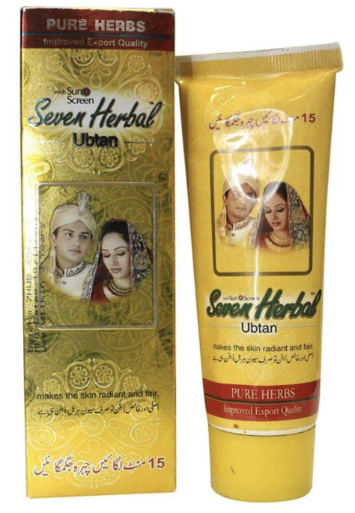
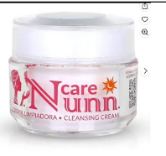
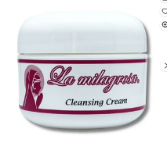
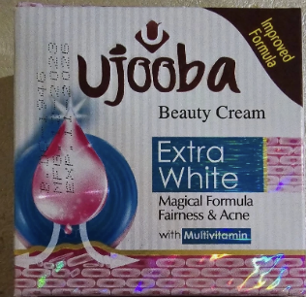
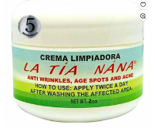
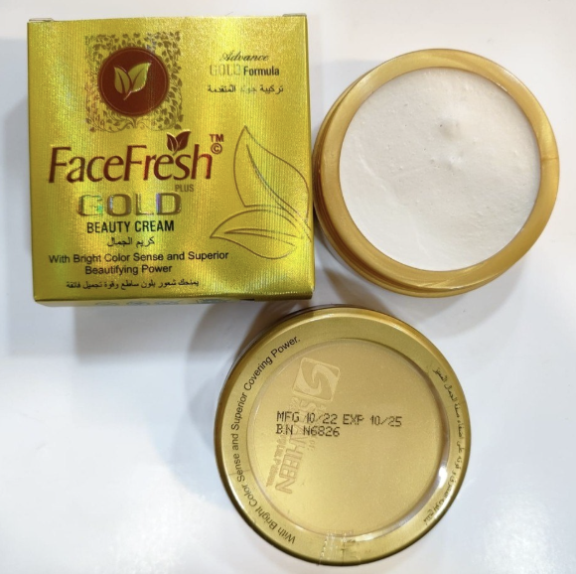
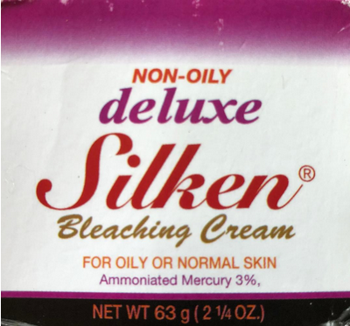
US Case Studies – Walmart & eBay, pending
Submitted by Mercury Policy Project under California Prop. 65 for failure to warn
29 January 2026 Lawsuit Against eBay (filed w/court):
Lawsuit alleges that eBay knowingly exposed consumers to mercury without the legally required warnings.
Testing of 40 SLPs found high levels of mercury, with one at 210,000 ppm
Among the SLPs tested, Deluxe Silken Cream contained 18,000 ppm
Sept. 2025 Lawsuit Notice Against Walmart (not filed w/court)
Testing of 3 SLPs found with high mercury
“Nunn Care” is of great concern given that two US state health departments have documented cases of poisoning from it
In the Minnesota case, the victim indicated that she purchased Nunn Care creams from both Walmart and Amazon
Currently in settlement discussions
Notes:
Sept. 2025 Lawsuit Notice Against Walmart (not filed w/court)
The California health department warns consumers to avoid all three creams; US FDA warns consumers about “La Tia Mana”
“Nunn Care” is of great concern given that Minnesota and Texas health departments have documented cases of poisoning from it
In the Minnesota case, the victim indicated that she purchased Nunn Care creams from both Walmart and Amazon
Walmart, Amazon and eBay were previously notified in 2022 by the State of Minnesota of Nunn Care’s mercury content (For example, see letter to Walmart )
Since notice was sent, Walmart.com has removed all 3 mercury added SLPs
Currently in settlement discussions
29 January 2026 Lawsuit Against eBay (filed w/court):
Lawsuit alleges that eBay knowingly exposed consumers to mercury from mercury added SLPs without the legally required warnings.
Testing of over 40 SLPs found dangerous levels of mercury — up to 210,000 times the US FDA’s threshold of 1 part per million.
SLPs sent to accredited lab in Minnesota and also to the California Department of Public Health for testing
By turning a blind eye toward online sellers that supply toxic SLPs, this business model promotes sale of unsafe products under the guise of legitimate commerce
Lawsuit also target third party sellers
Legal complaint available at: https://app.box.com/s/28apfqu9kn3ukzw78bizry5d35d1z3jp/file/2118325939131

Slide 42

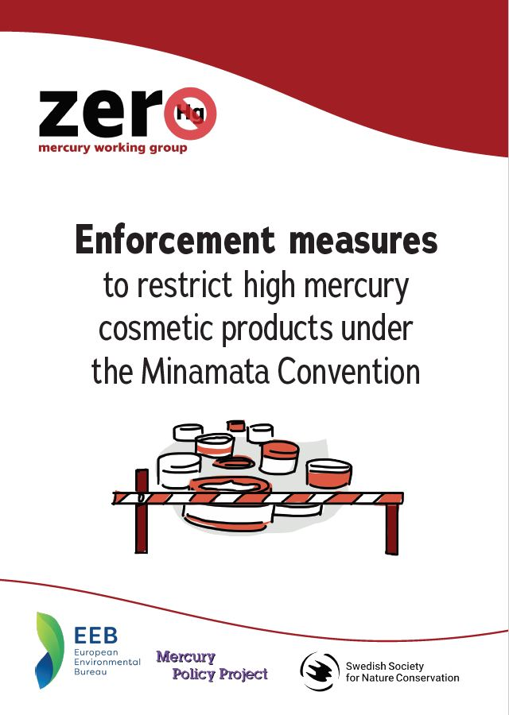
Targeted Enforcement Checklist
Legislation banning manufacture, import, export and sales of Hg/SLP
Cosmetics registered in the country
Importers of cosmetics/SLPs registered (+ manufacturers, distributors)
Online platforms selling in the country to register, in country contact, address
Database/ List of prohibited products
Labelling requirements
Systems in place to control the product entry with register, HS codes, names, key words
Online sales from individuals, products arriving via the post , go through customs, (spot check – from destinations, key words, etc) .
Sampling: XRF screening, analytical methods to determine mercury. New products found with mercury, to be notified and added on the prohibited products’ list.
Interagency and Regional Cooperation in place
Complementary voluntary agreements with platforms
Notes:
See Deal reached on Union Customs Code reform | News | European Parliament
How is this relevant for the notorious EU law / level playing field debate?
Platform responsibility
Under the new rules, sellers and platforms that facilitate distance sales of goods from non-EU countries directly to EU customers will be treated as importers. This will oblige them to provide customs authorities with all the necessary data, pay or guarantee any charges, and make sure that the goods comply with EU laws. These companies must be established in the EU or be represented by an EU-based entity having either authorised economic operator (AEO) or trusted trader status. This should prevent the use of shell companies.
So for platforms like amazon that are also established in EU the problem seems fixed?
But for Temo and Shein which to my understanding do not have an EU based facilitator the problem still exists.

Slide 43
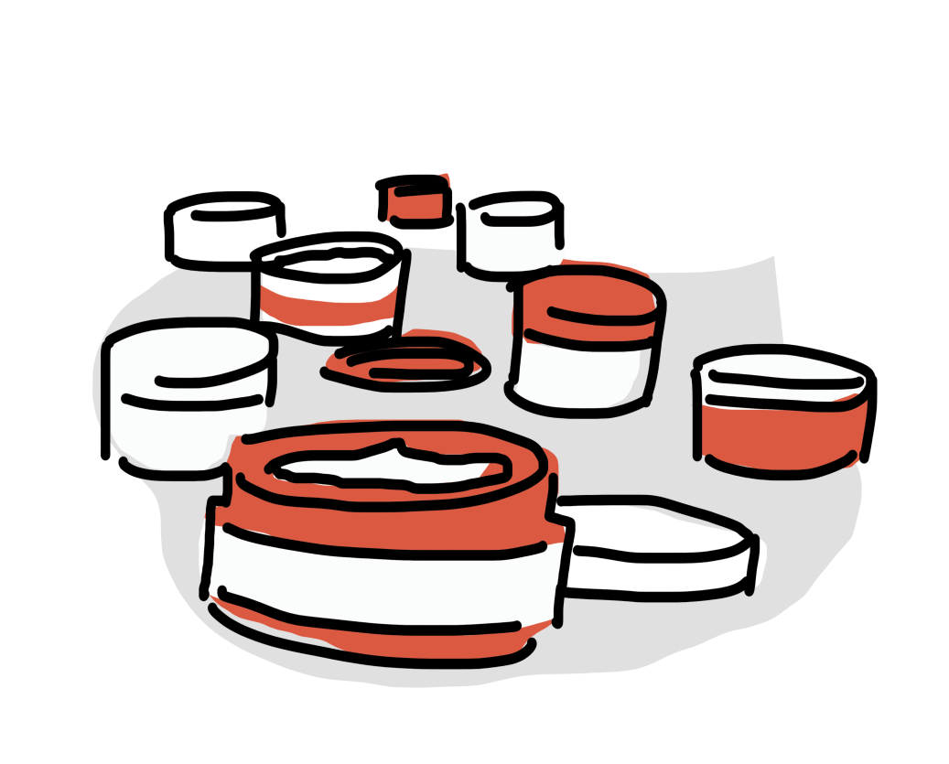

Summary
Legislation banning manufacture, import, export and sales of Hg/SLPS is the first step
Enforcement and tools necessary (e.g. prohibited products lists, legal settlements, sanctions, voluntary agreements, )
Interministerial/interagency cooperation necessary
Effective self policing by online platforms optimal, given limited government resources
Most online marketplaces have prohibited product policies, but often failing to enforce bans
Online marketplaces are generally receptive and cooperative, when contacted by authorities – dialogue necessary.

Slide 44
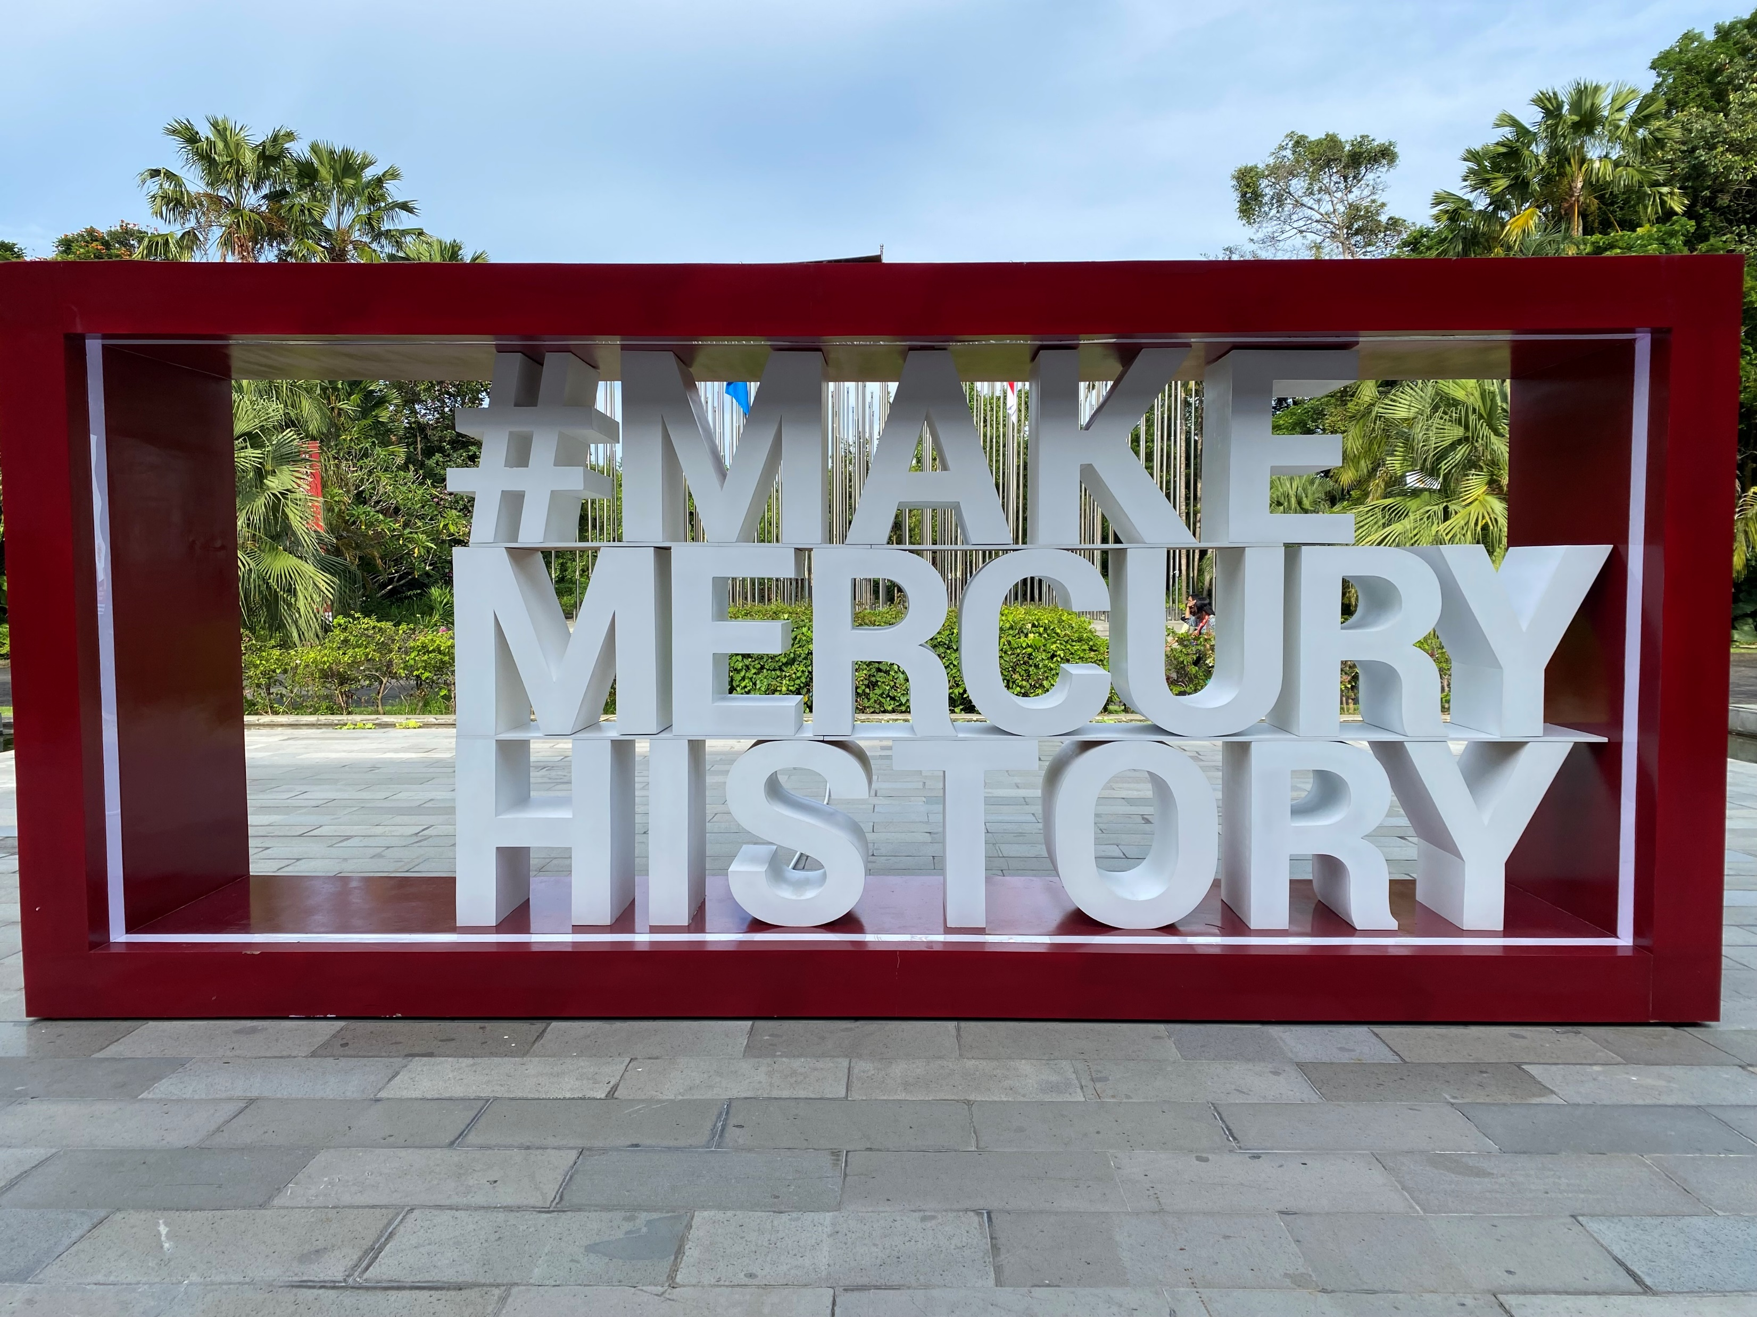
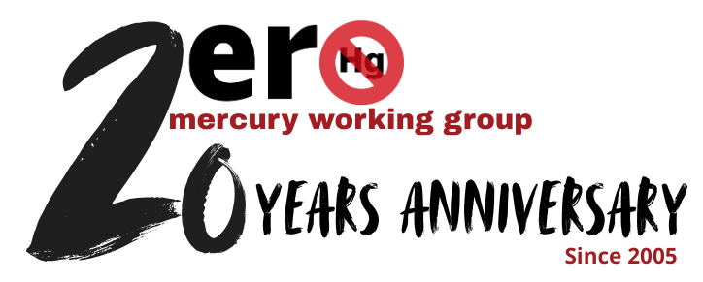
Thank you!
Thank you!
For more information: https://www.zeromercury.org/mercury-added-skin-lightening-creams-campaign/
Notes:
I hope you have found this input useful, more information can be found on our website, and looking forward to discussing with you more during the interactive session.
Thank you again for your attention.

Slide 45
TOOLS TO ENHANCE TRADE MANAGEMENT OF MERCURY-ADDED SKIN LIGHTENING PRODUCTS
Ashley Bastiansz, BRI

Slide 46


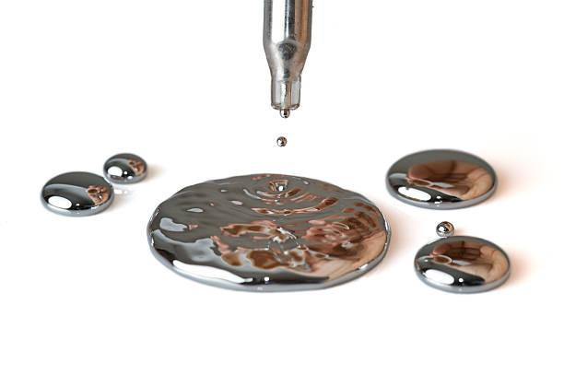
Tools to Enhance Mercury Trade Management: Identifying Mercury-added Skin Lightening Products: HS Codes, Database Use, Risk Profiling and Analytical Screening of Suspected Goods
Jamaica Customs and Enforcement Webinar
30 March 2026
GEF 10810 Project: Eliminating Mercury Skin Lightening Products
Ashley Bastiansz
Biodiversity Research Institute

Slide 47
Background of Mercury Risk
Risk assessment is essential for identifying and quantifying mercury exposure, supporting regulatory monitoring, and managing risks various settings (e.g., mining, industrial, and environment).
Risk assessment for mercury relies on inter-agency collaboration, risk profiling, analytical detection techniques, HS Codes, databases/detention lists, among others, which are essential for protecting human and environmental health, and guiding policy.

Slide 48
Importance of Managing Mercury Trade
Illicit mercury trade persists despite the Minamata Convention, and is driven by demand – especially in artisanal and small-scale gold mining (ASGM), and mercury-added products
Smuggling routes include land, sea and air, often involving concealed or mislabeled shipments
A multi-agency response is essential – engaging Customs, environment, health, trade and law enforcement sectors
Key impacts of illicit trade – environmental degradation, weakened legal and regulatory systems and increase human exposure to mercury
The global scale of the issue demands international collaboration and strong national coordination

Slide 49
Key Stakeholders and Roles in Controlling Mercury Trade
Customs administrations play a critical role in ensuring compliance with both international and national regulations, preventing illegal trade, and facilitating legitimate commerce.
Customs Agencies:
Conduct inspections and enforce import/export regulations
Apply commodity classification systems and risk-based profiling
Detect, seize, and detain illegal or undeclared mercury, mercury-added products, and mercury waste
Report findings and coordinate actions with relevant national and international agencies
Environmental Authorities:
Regulate hazardous substances, oversee compliance, and investigate pollution incidents.
Lead enforcement of environmental laws and mercury-related regulations
Issue licenses and permits for mercury use, trade, and handling
Detect and address mislabeling, diversion, or illegal disposal of hazardous mercury waste
Provide technical support for the safe storage, treatment, or disposal of seized mercury
Notes:
These are some examples of key stakeholders that can assist in controlling mercury trade

Slide 50
Key Stakeholders and Roles in Controlling Mercury Trade
Law Enforcement:
Conduct investigations, raids, and ensure legal accountability
Support arrests and prosecution of offenders
Uncover and dismantle organized criminal networks
Identify links between mercury trafficking and related crimes (e.g., illegal mining, smuggling
Health Authorities:
Identify unlicensed mercury use and illegal mercury trade channels
Provide technical expertise on mercury exposure and health risks
Monitor public health impacts of mercury
Support implementation and enforcement of health-related regulations
Assess risks to human health and promote safer alternatives

Slide 51
Applicability of Risk assessment methods in Mercury Trade Management
Risk assessment and profiling methods can be used to identify, assess, and prioritize high-risk trade activities involving mercury various mercury shipments, including:
Elemental mercury, mercury compounds, mercury-containing waste, and mercury-added products
Risk profiling can be executed by flagging shipments from high-risk regions, monitoring unusual trade volumes or routes, and screening traders with past violations
For the purposes of this presentation, mercury-added skin lightening products (SLPs) will be used as a case study.
This product category represents an emerging issue and is
more difficult to identify than elemental mercury.
However, the underlying principles and assessment methods
apply similarly across all mercury forms and product types.

Slide 52
Need for Standard Operating Procedures (SOPs)
Strategic Tool for Planning & Inspection: Well-developed and regularly updated SOPs support risk analysis and effective shipment inspections
Centralized & Adaptable Guidance: SOPs provide a reliable, centralized reference that evolves with changing needs and aligns with international standards
Key Elements of National SOPs:
Procedures consistent with the Minamata Convention and national laws
Clear definitions of roles and responsibilities for Customs and stakeholders
Detailed processes for managing imports, exports, transit, and trade involving mercury, mercury-added products, and waste

Slide 53
Important Elements for SOPs
Regulatory Framework: Reference to national laws and alignment with the Minamata Convention
Control Procedures: Step-by-step processes for inspecting and managing mercury and mercury-added product shipments
Shipment Identification: Methods for detecting, verifying, and classifying relevant goods
Risk Management & Enforcement: Guidelines for profiling, targeting, and conducting enforcement actions
Health & Safety Measures: Protocols to protect officers and prevent contamination
Illegal Traffic & Sanctions: Protocols for addressing violations and applying penalties
Training Provisions: Regular capacity building for frontline officers and stakeholders
Inter-Agency Cooperation: Coordination with competent authorities and relevant stakeholders

Slide 54

What to Look For?
Mercury is often not listed in the ingredients
Labelled with “Whitening”, “brightening”, “fairness”, “brighter”, “bleaching”, “anti-pigmentation”, etc.
“Mercury” listed as an active ingredient
Locally produced creams (prioritized)

Slide 55
What to Look For?
Banned or Restricted Ingredients
Look for these harmful or prohibited substances:
Mercury or mercury compounds (often labeled as): “Mercury,” “Mercurous chloride,” “Calomel,” “Mercurio,” or “Hg”
Hydroquinone (especially if over 2%)
Corticosteroids (e.g., betamethasone, clobetasol propionate, hydrocortisone)
Unknown chemical names or vague terms like “natural whitening agent” with no clear explanation
No Ingredients List or Incomplete List
Missing or extremely short ingredient lists can be a sign of concealment.
Vague terms like "botanicals" or "herbal blend" with no further breakdown.
Outlandish Claims
“Whitens skin in 3 days”
“Instant fairness”
“Guaranteed lightening overnight”
“Erases melanin”

Slide 56
What to Look For?
No Manufacturer Information
No clear manufacturer name, address, or country of origin
Sometimes only a foreign language with no translation
Lack of Regulatory Approval
No regulatory certification like: Fake approval logos or stamps
Strange Packaging or Label Design
Labels may look unprofessional, with: Poor grammar or spelling, Blurry printing, No expiration date or batch number
Imported Product Not in Local Language
Imported items without a translated label often bypass safety checks.

Slide 57
Identifying Mercury in SLPs:
A Case Study
HS Codes
Database
Analytical Testing

Slide 58
HS Codes
Mercury-specific HS codes exist for elemental mercury, compounds, and some products, e.g.:
HS 280540 – Mercury
HS 285200 – Inorganic/organic mercury compounds (excluding amalgams)
HS 853931 – Fluorescent discharge lamps (hot cathode)
Many mercury-containing products are classified under broader HS codes that are not mercury-specific. These codes cover mixed materials and products, meaning mercury trade is often hidden within non-mercury headings.
No globally harmonized HS codes exist specifically for all mercury-added products (including SLPs).
Countries may extend HS codes (8–10 digits) at the national level to identify mercury content.

Slide 59
HS Codes
Based on the low average value per kilogram of compound traded, it can be deduced that while the HS Code: 285210 – mercury compounds, chemically defined, inorganic or organic (excluding amalgams) – is meant to be used for only mercury compounds.
The volumes reflect that it includes byproduct compounds meaning that identifying commercial trade of mercury compounds is still not fully captured.
UNEP/MC/COP.6/INF/5 - Study of the global supply, production, trade and use of mercury compounds: https://minamataconvention.org/en/documents/unep-mc-cop-6-inf-5-study-global-supply-production-trade-and-use-mercury-compounds

Slide 60
HS Codes
Although specific HS codes for mercury-added products have not been universally adopted, countries can add extra digits (e.g., 8 or 10) to general cosmetic codes to track these specific illicit products (WCO Trade Tools)
National practice example – Uruguay:
Uses extended HS Codes for products including fluorescent lamps, mercury vapor lamps, and thermometers
Demonstrates technical capacity for mercury tracking, though not universal mercury-flag subheadings
International context:
Minamata Convention encourages voluntary HS Codes development for Annex A mercury-added products
Extended HS codes reduce ambiguity, improve compliance, enable smarter trade policy, and make cross-border trade run more smoothly for both governments and businesses.

Slide 61

Example of Implementing Hg SLP Actions in ASYCUDA (Automated System for Customs Data)
For project country, Sri Lanka, the national regulatory body published a notice on their ASYCUDA platform stipulating that all cosmetic importers must show necessary labelling of ingredients, be licensed to import etc.

Slide 62
Importance of Testing SLPs and Cosmetics for Mercury
Lack of Ingredient Transparency: Mercury is often not listed on product labels or have ingredients written in different languages, making it difficult for consumers, regulators, and health authorities to identify hazardous products based on packaging alone.
Limited Testing Capacity at Borders: Many customs agencies lack the equipment, expertise or resources to routinely test cosmetic products for mercury, allowing dangerous items to enter markets undetected.

Slide 63
Instruments commonly used for testing:
X-Ray Fluorescence (XRF)
Direct Mercury Analyzer (DMA)
Inductively Coupled Plasma Mass Spectrometry (ICP-MS)
Inductively Coupled Plasma Optical Emission Spectrometry (ICP-OES)
Cold Vapor Atomic Absorption Spectroscopy (CVAAS)
Cold Vapor Atomic Fluorescence Spectroscopy (CVAFS)
Atomic Absorption Spectroscopy (AAS)
Commercially available testing kits

Slide 64
X-Ray Fluorescence (XRF)
To enhance Customs’ capacities at the border, the use of rapid analytical equipment can be considered once determined to be economically feasible.
If there is suspicion that the product may contain mercury but is unlabeled or lacks clear ingredient information - Customs agents can take a sample of the product for rapid testing using XRF.
XRF analysis is a practical, non-destructive and effective screening method to confirm the presence of mercury.
It is widely used in regulatory enforcement, especially for illegal cosmetics, because it allows for quick, accurate, and reliable detection of mercury and other heavy metals, even in small amounts.

Slide 65


X-Ray Fluorescence (XRF)
Advantages
Non-destructive analysis: Samples remain intact after testing
Rapid, real-time results: Immediate data for fast decision-making
Cost-effective workflow: Reduces laboratory analysis and sample transport needs
Versatile multi-element detection: Capable of measuring mercury and other elements
Field-to-lab flexibility:
Handheld XRF enables portable, on-site screening and handles high mercury concentrations
Desktop XRF delivers higher accuracy, precision, lower detection limits, and additional safety
Reliable and robust: Advanced instrumentation and controlled environments minimize operator variability
Disadvantages
Higher detection limits: Compared to more sensitive techniques (e.g., Direct Mercury Analyzers), XRF may be less suitable for ultra-trace mercury analysis.
Sample heterogeneity effects: Accuracy can be inconsistent, with error rates increasing in heterogeneous or high-moisture samples.
Calibration requirements: External calibration curves are often needed for quantitative results beyond preliminary screening.
Space requirements: Desktop instruments are bulky and require dedicated laboratory space.
Notes:
video to be shared, certain agencies like ICENS and Bureau of Standards and they can be engaged

Slide 66
Global Database
There are several key databases and resources used internationally and regionally to monitor mercury-added SLP.
All mercury-added SLP concentrations from Jamaica, Gabon and Sri Lanka under this project are kept in a centralized database developed in coordination with the UNEP Global Mercury Partnership and will be publicly available in April 2026.
Over 4,000 SLP sample results obtained.
Sources reviewed included:
Over 50 Published Journal Articles
Datasets from Zero Mercury Working Group (ZMWG) who provided data on 1185 SLPs from their research
Databases/Reports released by recognized entities (NGOs and monitoring agencies)

Slide 67

Database
This database can be used to identify: potential hubs for production, patterns of distribution, products of interest for testing in project countries/regions
To be used as a ‘living database’ for Customs agents to access and use as a reference tool
Government agencies can also submit SLPs identified at the border with mercury to BRI or UNEP GMP to include in this global database (e.g., National contraband lists)

Slide 68


Developing Implementation Strategies for Cross Collaboration
Capacity Building & Training
Conduct cross-agency training on mercury detection, handling, and documentation
Hold workshops on national laws and the Minamata Convention
Conduct laboratory testing for mercury analyses
Engage international experts to share global best practices
Communication & Coordination
Assign focal points in each agency to streamline coordination and establish secure communication Use standardized templates (e.g., seizure reports, risk alerts) and maintain shared databases for flagged traders, routes, and permits
Hold regular coordination meetings and joint situation reporting to align efforts and share real time alerts

Slide 69







Developing Implementation Strategies for Cross Collaboration

Slide 70


Available Resources
Other organizations have contributed to assisting this issue by developing reference tools to help consumers, customs agencies and other stakeholders identify these products:
a)Zero Mercury Working Group (ZMWG): Enforcement measures to restrict high mercury cosmetic products under the Minamata Convention
b)Organization for Economic Co-operation and Development (OECD): POLICY GUIDANCE ON CONSUMER PRODUCT SAFETY PLEDGES
c)The European Union's Rapid Alert System for dangerous non-food products (RAPEX)
Although these tools have been developed under the European context, they can be used as reference materials in Caribbean specific contexts

Slide 71



Available Resources
World Customs Organization
Standard Operating Procedures for controls of waste shipments (2024)
Illicit Trade Report (2023)
Harmonized System - General Rules for Interpretation

Slide 72


Available Resources
Guidelines for Waste Management
The Basel Convention sets international rules for the movement of hazardous wastes, including those with mercury.
It classifies mercury-containing waste as hazardous and restricts its cross-border trade.
The Convention specifically prohibits developed countries from exporting mercury waste to developing countries for disposal or recycling.
Its technical guidelines offer best practices for safely managing, storing, and disposing of mercury waste to minimize environmental and health risks.
Notes:
Include to note - that outside of SLPs that would follow Basel Guidelines

Slide 73



Available Resources
Global Mercury Partnership (GMP)
Coordinated by UNEP to deliver evidence-based expertise and stakeholder collaboration that helps governments, industries, NGOs, and researchers tackle mercury pollution effectively and support implementation of the Convention
Focuses on 8 areas of work including: Artisanal and small-scale gold mining (ASGM), Mercury releases from coal combustion, Mercury in products (i.e., skin-lightening products, dental amalgam, medical devices), and Mercury waste management
GMP offers technical assistance and guidance for mercury across sectors, and capacity building projects
Through their website you can identify and network with partners that are working in the respective 8 areas of work
Resources are also available on their website to keep up to date with ongoing projects among partners worldwide

Slide 74




Thank you! Questions?
Ashley BASTIANSZ
INTERNATIONAL ENVIRONMENTAL SPECIALIST
ashley.bastiansz@briwildlife.org
www.briwildlife.org
For more information on the project, visit: https://www.unep.org/mercuryfreecosmetics
#mercuryfreecosmetics

Slide 75

VIRTUAL WORKSHOP ON MERCURY-ADDED SKIN LIGHTENING PRODUCTS: CUSTOMS & ENFORCEMENT TRAINING
*5-minute health break*

Slide 76
UPDATES ON ENFORCEMENT ACTIONS IN JAMAICA FOR MERCURY-ADDED SKIN LIGHTENING PRODUCTS Ms. Alicia Smith, Standards and Regulations Division, Ministry of Health and Wellness

Slide 77
OPEN DISCUSSION ON NEEDS AND CAPACITIES FOR ENFORCEMENT OF BANS OF MERCURY-ADDED SKIN LIGHTENING PRODUCTS

Slide 78
Discussion Questions
What level of coordination does the Jamaica Customs Agency currently have with other agencies (e.g., Health, Environment, standards authorities) regarding harmful or non-compliant products?
How is information shared and joint action coordinated between Customs and these agencies (e.g., formal agreements, joint operations, informal communication)?
What procedures are followed when harmful or non-compliant products are confiscated, and which agencies are involved afterward?
Does Customs participate in market surveillance activities beyond points of entry, and if so, what is its role?
What are the main challenges or gaps in interagency collaboration, and what support or improvements would strengthen coordination?

Slide 79


Slide 80


Slide 81


www.unep.org/mercuryfreecosmetics

Slide 82
All materials from the session and supporting documents will be shared via email in the coming week.
THANK YOU FOR YOUR PARTICIPATION!

